Slide 1

A Neural Network for Car-Passenger matching in Ride Hailing Services.
Karim Akhnoukh
Technische Universität München
Fakultät für Informatics
Lehrstuhl für Connected Mobility
Ort, Datum (Garching: 12. June 2019)

Slide 2
Outline
Introduction
Literature Review
Methodology
Results
Conclusion

Slide 3
Outline
Introduction
Literature Review
Methodology
Results
Conclusion

Slide 4


Introduction
Traveling Salesman Problem (TSP)
  Shortest path to traverse all locations
  NP hard

Slide 5

Introduction
Traveling Salesman Problem (TSP)
Vehicle Routing Problem (VRP)
  One start and end depot
  Time constraint
  Capacity constraint

Slide 6
Introduction
Traveling Salesman Problem (TSP)
Vehicle Routing Problem (VRP)
Car-Passenger matching in Ride Hailing
  Many cars
  Different depots locations
  Time constraints

Slide 7





Motivation

Slide 8
Publication:
  A. Sayed, K. Akhnoukh and K. Bogenberger (2019) "Neural Network based Large Neighborhood Search Algorithm for Ride Hailing Services“. EPIA conference on Artificial Intelligence.
Patents:
  Recurrent Neural Network based vehicle assignment for On Demand Mobility Services
  Recurrent Neural Network based insertion for Adaptive Large Neighborhood Search algorithm for On Demand Mobility Services

Slide 9
Outline
Introduction
Literature Review
Methodology
Results
Conclusion

Slide 10
Sequence to Sequence Network [1]
Variable length input to variable length output
Output dictionary of fixed size
Encoder
Decoder
W
X
Y
Z
EOS
Input vector
C
B
A
EOS

Slide 11
Pointer Network [2]
Output size depends on input
Combinatorial optimization problems such as TSP
Encoder
Decoder
X₄
X₁
X₂
X₃
X₃
X₂
X₄

Slide 12
Reinforcement learning for VRP [3]
Based on Ptr-Net
Replace the LSTM encoder with an embedding layer
Added dynamic features
Tested for CVRP with 1 car and up to 100 requests

Slide 13
Outline
Introduction
Literature Review
Methodology
Results
Conclusion

Slide 14

Problem Formulation
Multi objective function:
Subjected to:
1.
2.
3.

Slide 15


Large Neighborhood Search (LNS)
LNS:
    Build initial solution
    Shake solution
    Repeat above two steps until stopping condition
LNS for Vehicle Routing Problem
    Insert new requests
    Remove some requests (Shake Phase)
    Keep repeating until stop condition
Insertion and removal operators determine solution quality
Problem:
Put maximum coins in the jar
Initial insert
Repeat insert
Initial solution
Remove some coins
Shake the solution
Move to and from

Slide 16
Neural Network Architecture
Modifications to [3]:
  Supervised learning technique
  Multiple vehicles
  Pickup time windows for requests
  Multiple slots per vehicle

Slide 17
Neural Network Architecture
Modifications to [3]:
  Multiple vehicles
  Pickup time windows for requests
  Multiple slots per vehicle
Input sets:
  Requests
  Vehicles
  Slots
  Input size: Number of Reqs × Number of vehicles × Number of slots

Slide 18


Neural Network Architecture
0.3
1e-5
0.05
0.25
……...
3e-6

Slide 19
Outline
Introduction
Literature Review
Methodology
Results
Conclusion

Slide 20
Experimental Details
Requests are generated from NYC Taxi dataset [4]
Distances Matrix is obtained using OSRM [5]
For training, 1000 Instances for different problem sizes are solved using LNS:
  m¹⁰ l²⁰
  m¹⁰ l³⁰
  m¹⁰ l⁴⁰
For testing, 10 instances of each:
m¹⁰ l²⁰
m¹⁰ l³⁰
m¹⁰ l⁴⁰
m¹⁵ l⁶⁰
m²⁰ l⁸⁰
m²⁵ l¹⁰⁰

Slide 21
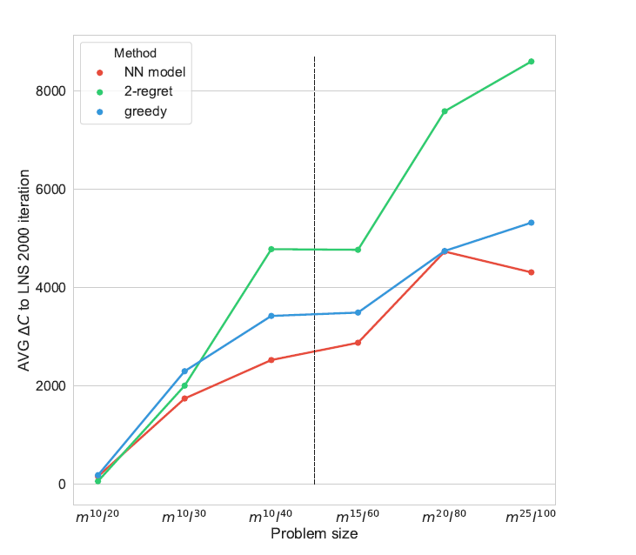
NN model vs Heuristics
Initial solution with one iteration of:
  NN model
  Greedy: chooses the assignment of smallest incremental cost
  2-regret: chooses the assignment that we will regret the most if not chosen.
Compared to solutions solved by LNS with 2000 iteration

Slide 22
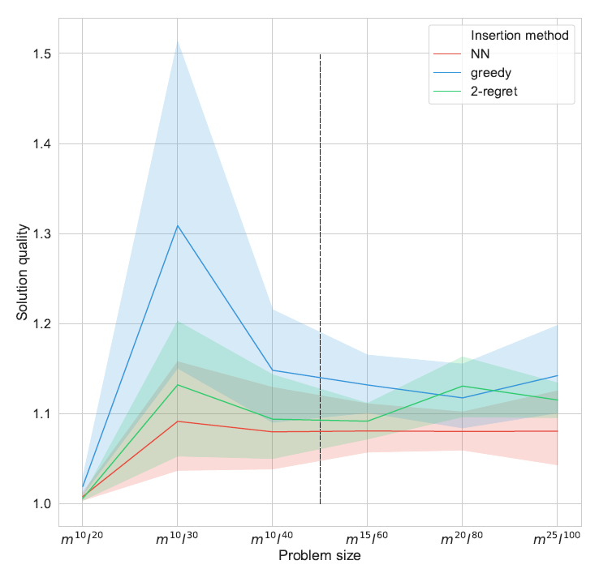
Insertion operator inside LNS
Solve the test set by LNS with using different insertion operators :
  NN
  Greedy
  2-regret
Obtain the solution quality as follows:
  Solve each problem with NN, greedy and 2-regret as insertion strategy, 5 times each
  Choose the best solution for each of the 10 example (out of the 15 solution)
  Take the average of five solutions for each insertion strategy
  Compare the average solution with the best solution.

Slide 23
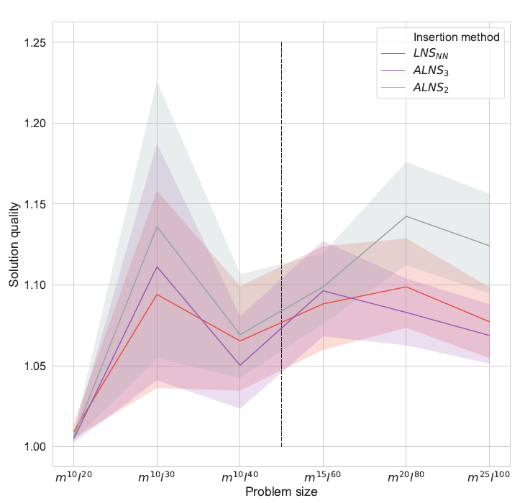
Adding the NN model to ALNS
Three solvers:
  LNS_{NN}: contains only NN as insertion operator
  ALNS₃: contains NN, greedy, 2-regret as insertion ops
  ALNS₂: contains greedy, 2-regret as insertion ops

Slide 24
Outline
Introduction
Literature Review
Methodology
Results
Conclusion

Slide 25
Summary
Modifications to [3]:
    Add more vehicles
    Introduce time constraint per request
    Add multiple slots per vehicle
    four dynamic feature, no static ones
    Supervised learning with modified loss function
Comparisons:
    One iteration versus other heuristics
    Insertion method to LNS
    Insertion methd to ALNS

Slide 26
Future work
    Try other decoding strategies
    Adapt the model to other routing problems
    Add the model to a real-time dynamic environment

Slide 27
References
[1] Sutskever, I., Vinyals, O., & Le, Q. V. (2014). Sequence to Sequence Learning with Neural Networks. ArXiv:1409.3215 [Cs]. Retrieved from http://arxiv.org/abs/1409.3215
[2] Vinyals, O., Fortunato, M., & Jaitly, N. (2015). Pointer Networks. ArXiv:1506.03134 [Cs, Stat]. Retrieved from http://arxiv.org/abs/1506.03134
[3] Nazari, Mohammadreza, et al. "Reinforcement Learning for Solving the Vehicle Routing Problem." Advances in Neural Information Processing Systems. 2018.
[4] https:// www1.nyc.gov/site/tlc/about/tlc-trip-record-data.page.
[5] http://project-osrm.org/.

Slide 28
Questions!

Slide 29
Backup slides

Slide 30
Neural Network Architecture
Features:
    Cost of insertion
    Number of outgoing edges
    Number of available cars
    Regret function
Loss function:

Slide 31
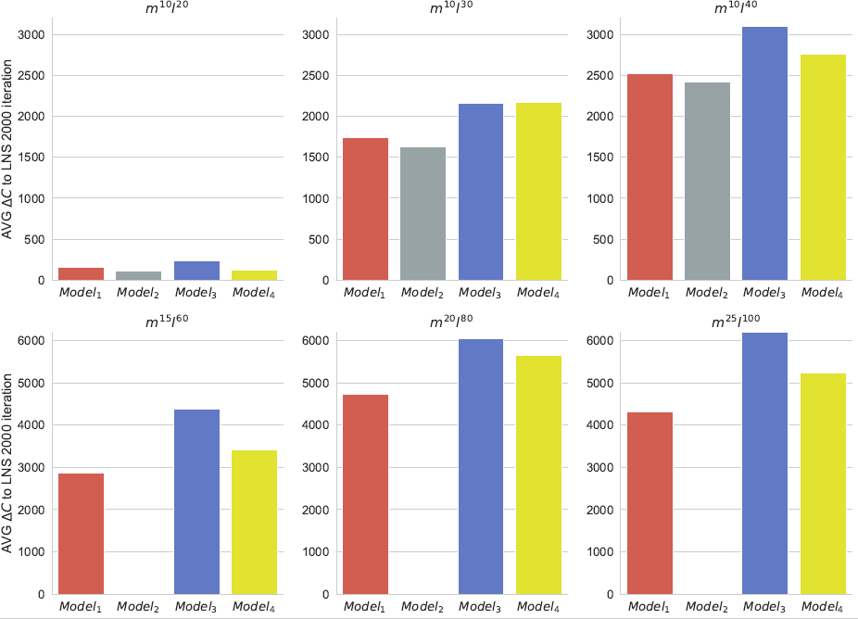
Different trained models
Model₁:
  All problem instances at once
  4 features
  Slot length 6
Model₂:
  Trained on every problem size individually.
  4 features.
  Slot length 6
Model_{3:}
  All problem instances at once
  4 features
  Slot length 1
Model₄:
  3 features
  Slot length 6

Slide 32
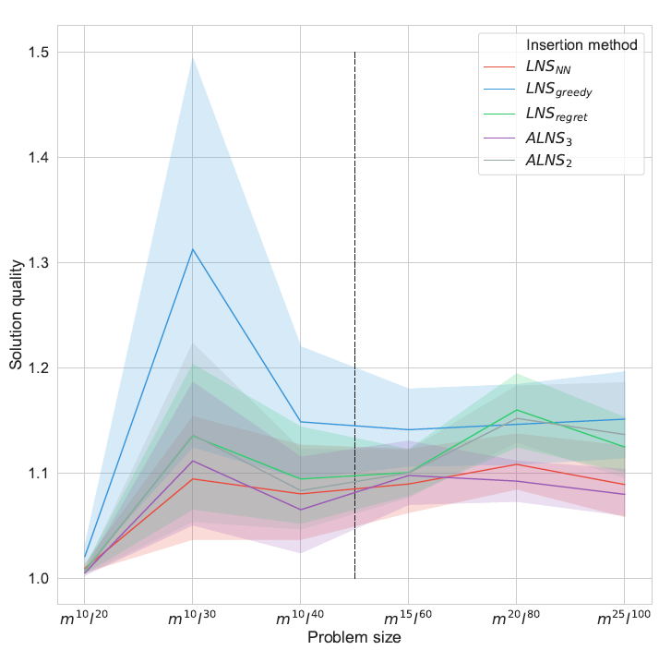
Comparison summary
All solvers:
  LNS_{NN}: contains only NN as an insertion operator
  LNS_{greedy}: contains only the greedy heuristic as an insertion operator
  LNS_{regret}: contains only the 2-regret heuristic as an insertion operator
  ALNS₃: contains NN, greedy, 2-regret as insertion ops
  ALNS₂: contains greedy, 2-regret as insertion ops

Slide 33
Neural Network Architecture
Embedding: maps input to higher dimension
Attention layer: produces softmax probability over the inputs.
Mask: eliminates the invalid assignments.
Greedy decoder: chooses the input with highest probability to be the next output.
RNN decoder: stores the output assignments.

