Slide 1
Future Internet Protocols, Consolidation and Decentralization
David Guzman, Justus Fries
Chair of Connected Mobility
TUM School of Computation, Information and Technology (CIT)

Slide 2
Outline
Introduction
Goals
What is this seminar about?
Grades
Presentation, Review and Participation
Organizational Matters
Papers

Slide 3
Introduction
Internet architectures, designs, and algorithms, decentralization and consolidation
Session 1: Algorithmic approaches in distributed (decentralized) systems
Session 2: Decentralizing distributed systems (use cases)
Session 3: Current state of decentralized systems
We read, review, present and discuss papers
Face-to-face seminars (this introductory session is the ONLY one online-enabled)

Slide 4
What are the Goals?
Skill set: REVIEWER and PRESENTER
Learn: state-of-the art designs, methodology, open questions
Through: publication process, peer review scientific conference/workshop
ARGUMENTATIVE papers, SYSTEM designs, ALGOs testing/reporting
Presenting (Idea), Modeling, and Testing (importance of reproducibility and artifacts)
How are good research papers presented in written form?
Critical thinking while reading/reviewing/presenting papers
Questioning content, identifying strengths/weaknesses
Extract key results and main findings → takeaways
Presentation and discussion of results

Slide 5
How Does a Conference Work? How do we do it (here)?
A regular conference paper publication process:
Call for Papers: Submission deadline
Round of reviews by technical committee: decision to accept/reject?
Accepted papers are presented/discussed (Q&A)
In this Seminar: REVIEWS and PRESENTATION
Pre-selected (published) papers on Internet Protocols and Decentralization
We do 3 SESSIONs (after this introduction)
YOU present ONE paper during the seminar
1 presentation for the entire seminar
YOU review TWO papers per session
4 reviews during the entire seminar

Slide 6
How Papers are assigned?
YOU send us 7 PAPERS of your preference for presenting (NOT GRADED)
ALL papers are shown at the end of this introductory session
YOU present ONE paper (GRADED)
First come, first served
WE assign 2 PAPERS per student per session (unless presenting).
YOU review 2 PAPERS per session (GRADED)
Ex.: Session 1, Student A reads and reviews Paper X and Y
Each review includes ONE QUESTION per paper ( GRADED)

Slide 7
How do we grade?
YOU send us a pool of 7 PAPERS of your preference (NOT GRADED)
ALL papers are shown at the end of this introductory session
YOU present one of your preferred papers -> PRESENTATION 40%
First come, first served
WE assign 2 PAPERS per student per session.
YOU review 2 PAPERs per session -> REVIEW 40%
ONE QUESTION per paper -> PARTICIPATION 20%

Slide 8
Grade
Presentation 40%
Review 40%
Participation (on-site) 20%

Slide 9
How to Present?
Motivate the subject/topic (~15% of time)
Explain the finding/idea/design/protocol/model/methodology (~40% of time)
Simplicity and core idea
Present and discuss main/most interesting result (~30% of time)
Usually summarized in abstract
Summarize main findings/conclusions (~10% of time)
Describe outlook/future work
YOU add your own thoughts on the paper in 1 slide (~5% of time)
e.g., strengths weaknesses, limitations, you like it or not (WHY)
Practice your presentation
Get feedback from your fellow students
Be aware of the time limit of 15min (timing is part of the grade!)

Slide 10
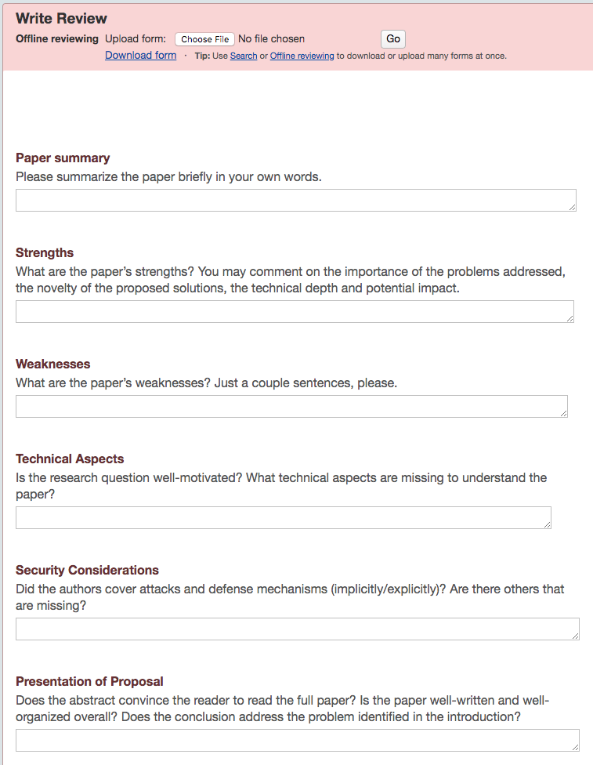
How a Review Looks?
Paper Summary
Strengths
Weakness
Technical Aspects
Novelty/Applicability/Impact
Presentation(Writing)

Slide 11
How to HotCRP?
WE invite each student to OUR HotCRP
Check email address (login) in invitation email
Registration form: affiliation/collaborators can be anything (e.g., TUM)
Papers are imported to HotCRP for reviewing
Reviews are due until the presentation date

Slide 12
How to Participate? QA (Discussion)
IN a session YOU either review OR present
What is the paper proposing/modifying?
Authors propose use cases, architectures, designs, and algorithms
Evaluate those based on measurements and (underlying) models
Feasibility of the design/architecture/algorithm
Evaluation and reproducibility
Are there experiments verifying/validating the idea?

Slide 13
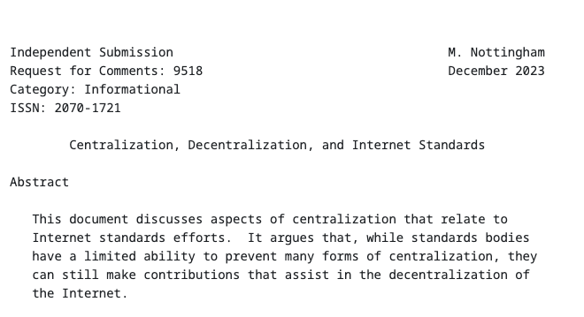
Get Ready to Pick a Paper
PLEASE read this draft before you pick a paper: https://datatracker.ietf.org/doc/rfc9518/
At least the first 3 Sections will set the language for further readings
These (3) sections are a 15min U-Bahn read

Slide 14
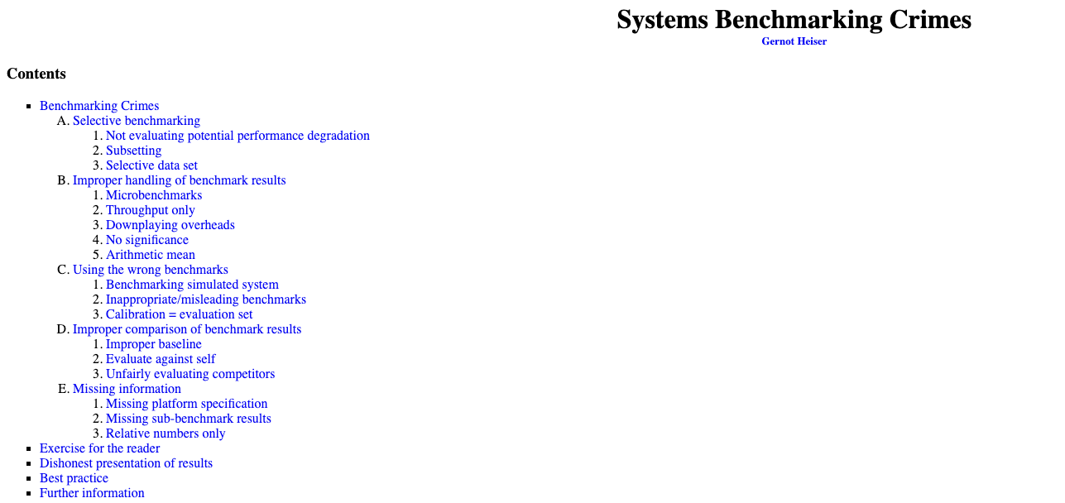
How to Think about a System Evaluation?
https://gernot-heiser.org/benchmarking-crimes.html

Slide 15
Organizational Matters
Send your preference
Students send preferences (7 papers) by email (cc the other lecturers)
Lecturers will (FIFO best effort) assign papers to each student
Paper assignment $⟷$ session $⟷$ presentation date
Schedule
Check Moodle or further information on the course webpage
Preference -> s1 -> s2 -> s3 -> grading
Send emails with reasons in advance if you can not attend

Slide 16
Organizational Matters
On-site (online only intro): 5607.01.023
https://nav.tum.de/room/5607.01.023
23 April Wednesday 15:00 Intro
20 May Tuesday 16:00 Session 1
3 June Tuesday 16:00 Session 2
17 June Tuesday 16:00 Session 3

Slide 17
Papers
Algorithms
Mercury: Fast Transaction Broadcast in High Performance Blockchain Systems. Infocom’23
﻿Strategic Latency Reduction in Blockchain Peer-to-Peer Networks. PAM’23
Kadcast: A Structured Approach to Broadcast in Blockchain Networks. (Workshop)’2019
Perigee: Efficient Peer-to-Peer Network Design for Blockchains. PODC’2020
Decentralizing Systems
Virtual Stars, Real Fans: Understanding the VTuber Ecosystem. WWW’24
Design and evaluation of ipfs: A storage layer for the decentralized web. Sigcomm’22
Looking AT the Blue Skies of Bluesky IMC’24
Bootstrapping Social Networks: Lessons from Bluesky. ICWSM’25
ReP2P Matrix: Decentralized Relays to Improve Reliability and Performance of Peer-to-Peer Matrix. CoNEXT’24
Towards a Decentralized Internet Namespace. CoNEXT’24
What is happening in Decentralized Systems? (Pros and Cons)
Fediverse Migrations: A Study of User Account Portability on the Mastodon Social Network. IMC’24
The Cloud Strikes Back : Investigating the Decentralization of IPFS. 391–405. https://doi.org/10.1145/3618257.3624797
Piecing Together the Jigsaw Puzzle of Transactions on Heterogeneous Blockchain Networks. Sigmetrics’24
A flash(bot) in the pan: measuring maximal extractable value in private pools IMC’2022
Communication Cost for Permissionless Distributed Consensus at Internet Scale. CoNEXT’24

