Slide 1
Influence of Pokémon Go on Physical Activity: Study and
Implications
Sharada Sowmya,
13.06.2019

Slide 2
Agenda
Significance of Physical Activities
About Pokémon Go
Research questions
Methodology
Results
Limitations
Conclusion

Slide 3
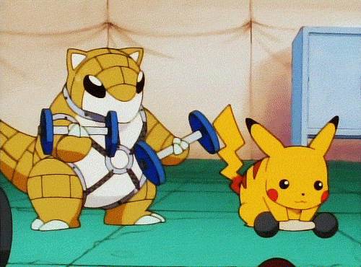
Significance of Physical Activities

Slide 4
Why is physical activity important?
“Those who think they have no time for bodily exercise will sooner or later have to find time for illness.”
- Edward Stanley,
Earl of Derby, December 20, 1873
Physical activity is critical to human health
More physical activity =>
longer life
less prone to diseases

Slide 5
Snapshot of health status
Worldwide, lack of physical inactivity contributes to
5.3 million deaths per year
economic burden of US $67.5 billion
Only 21% of US adults meet official physical activity guidelines
Less than 30% of US high school students get at least 60 minutes of physical activity everyday

Slide 6
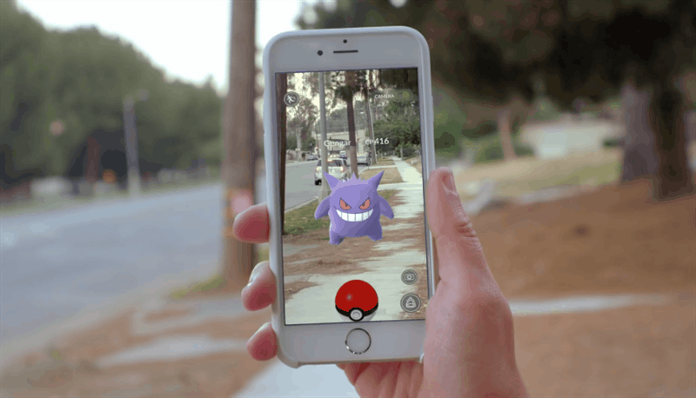
About Pokémon Go

Slide 7
What is Pokémon Go?
Augmented reality mobile game
Uses the mobile device GPS to locate, capture, battle, and train virtual creatures aka Pokémon
Bridges real world with the virtual Pokémon universe
Most-downloaded in its first month of release
800 million downloads worldwide.

Slide 8
Pokémon Go and physical activity
Pokémon Go requires physical engagement of users with outside world
Locating rare pokemons requires considerable amount of physical activity for the players.
PokéStops makes you take the extra few steps to re-equip
Outside Gym battles always better than games on couch.

Slide 9
Main research questions
Does playing Pokémon Go increase physical activity?
How large is this effect and how long does it persist?
Is it affecting people of all ages, gender, and weight status?
Effects of Pokémon Go on physical health vs other mobile health apps ?
What is the impact in United States and potential implications if the app sustains user engagement for long time?

Slide 10
Methodology

Slide 11
Step 1: Data query and analysis
The study population consisted of 31,793 US users of Microsoft products.
1420 users were (potential)Pokémon Go players
Analysis of data was conducted based on-
Queries from users to the Microsoft Bing search engine mentioning keyword “pokemon.” was collected.
Physical activity data of users gathered on Microsoft Band based on daily number of steps

Slide 12
Step 2: Identification Pokémon Go Users
Bing search queries mentioning “pokemon” of 31,793 users between July 6, 2016 and August 23, 2016 were taken.
Experiential vs Nonexperiential query in the context of Pokémon Go.
1420 out of 25,446 users were recognized as Pokémon users.

Slide 13
Step 3: Measuring Physical Activity
The daily steps were recorded using the Accelerometer and gyrometer of the wrist-worn Microsoft Band.
Steps data from 30 days before and after the first experiential query (t0) were collected
However, not every potential Pokémon Go user tracks steps regularly.
Therefore, study was restricted to 792 users who tracked steps on at least one day before and after t0

Slide 14
Step 4: Addition of Control group
Control group is a random sample of US Microsoft wearable users.
No common reference point t0 for control users
Possible t0 could be July 6, 2016 release date of Pokémon Go.
Each control user was randomly mapped to a Pokémon Go user and control user used the same t0 as the Pokémon Go user.

Slide 15
Step 5: Measuring the Impact of Pokémon Go
Pokémon Go vs Control users
Dose-Response Relationship Between Pokémon Go and
Physical Activity
Benefits to different user groups
Comparison With four Existing Health Apps with user base of 1155, 313 ,625 and 296 respectively.
Public Health Impact of Pokémon Go

Slide 16
Results!

Slide 17
Population Demographics
DataSet | PokémonGo users | Control users
Number of users | 1420 | 1420
Number of users with sufficient activity data | 792 | 26,334
Median age | 33 | 42
% female | 3.8 | 25.7
% underweight (BMI<18.5) | 1.1 | 1.2
% normal weight (18.5≤BMI<25) | 34.2 | 31.4
% overweight (25≤BMI < 30) | 36.5 | 38.4
% obese (30≤BMI) | 28.2 | 29.1
Average daily steps overall | 6258 | 6435

Slide 18
Population Demographics Analysis
Pokémon Go users are younger than the average user in our wearable dataset
Gender bias due to the users’ agreement to share data
However, there is no evidence for a significantly different effect between males and females in the dataset
The average activity level of Pokémon Go users is below that of the control group => Pokémon Go is attracting users that get less than average activity.

Slide 19
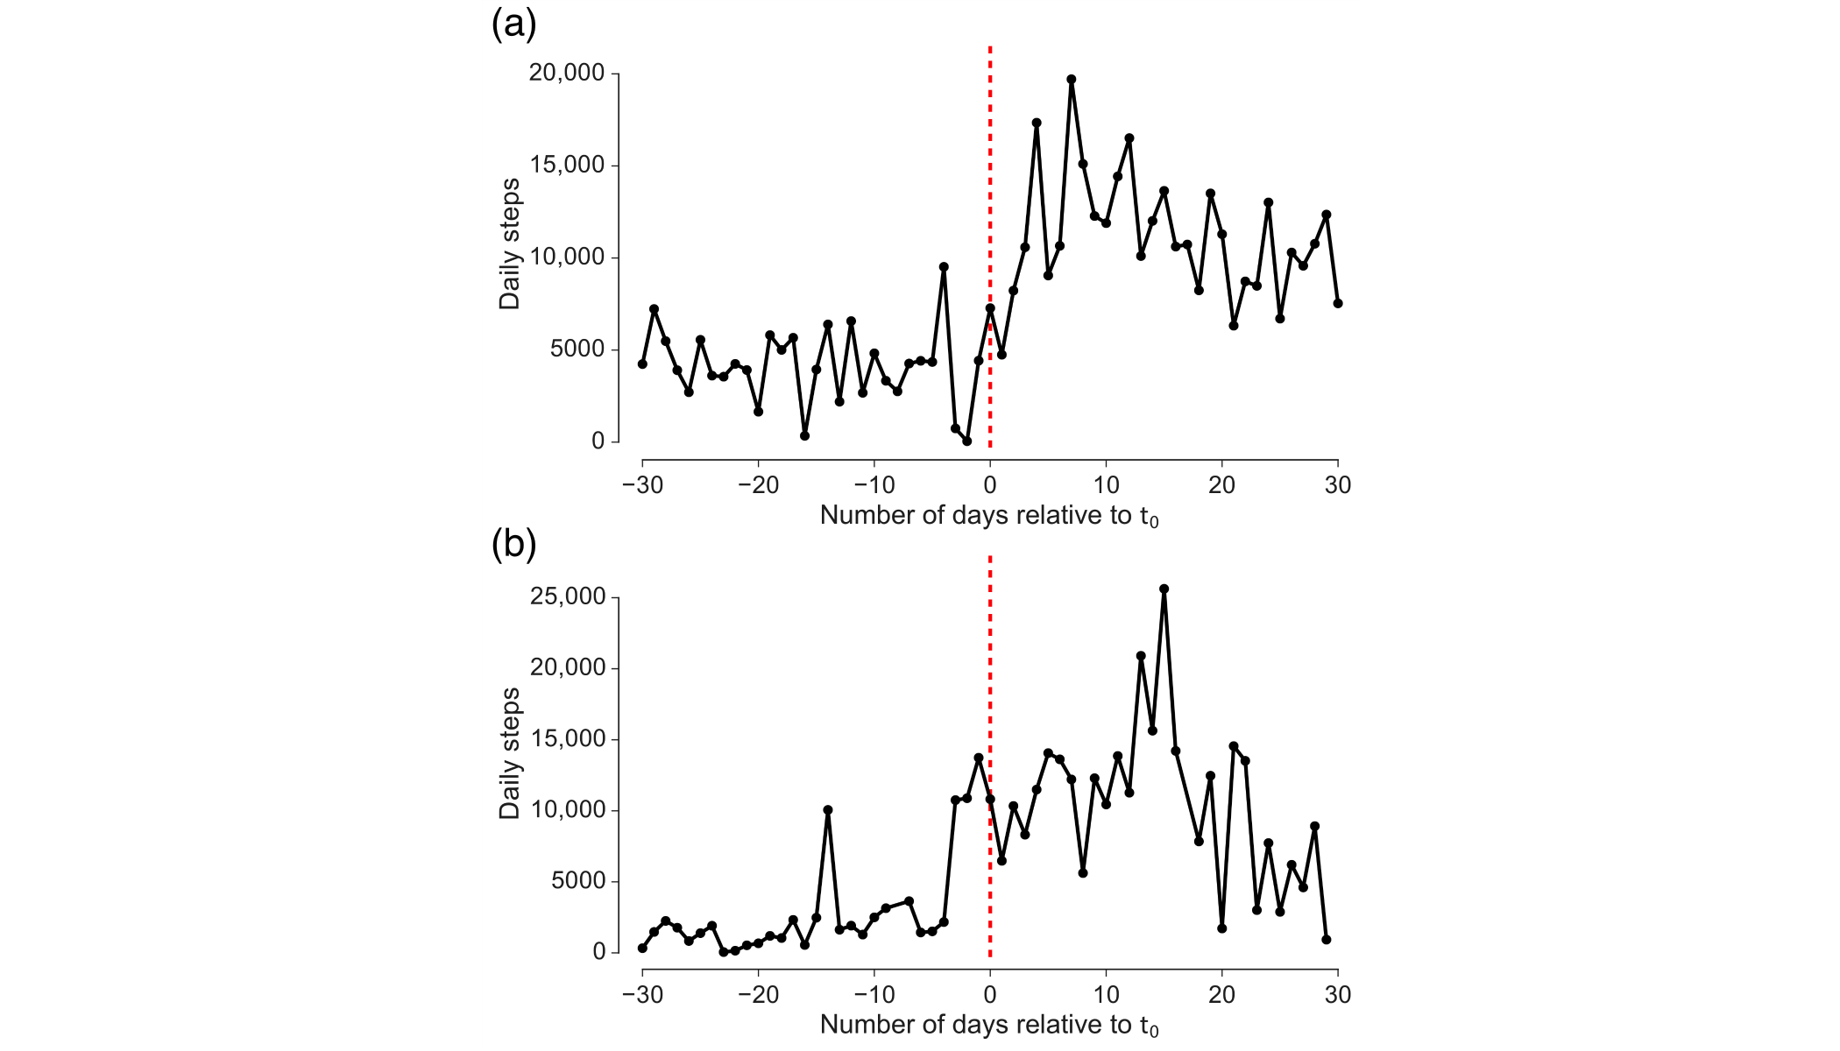
Time Series of Physical Activity
Pokémon Go user A
Pokémon Go user B

Slide 20
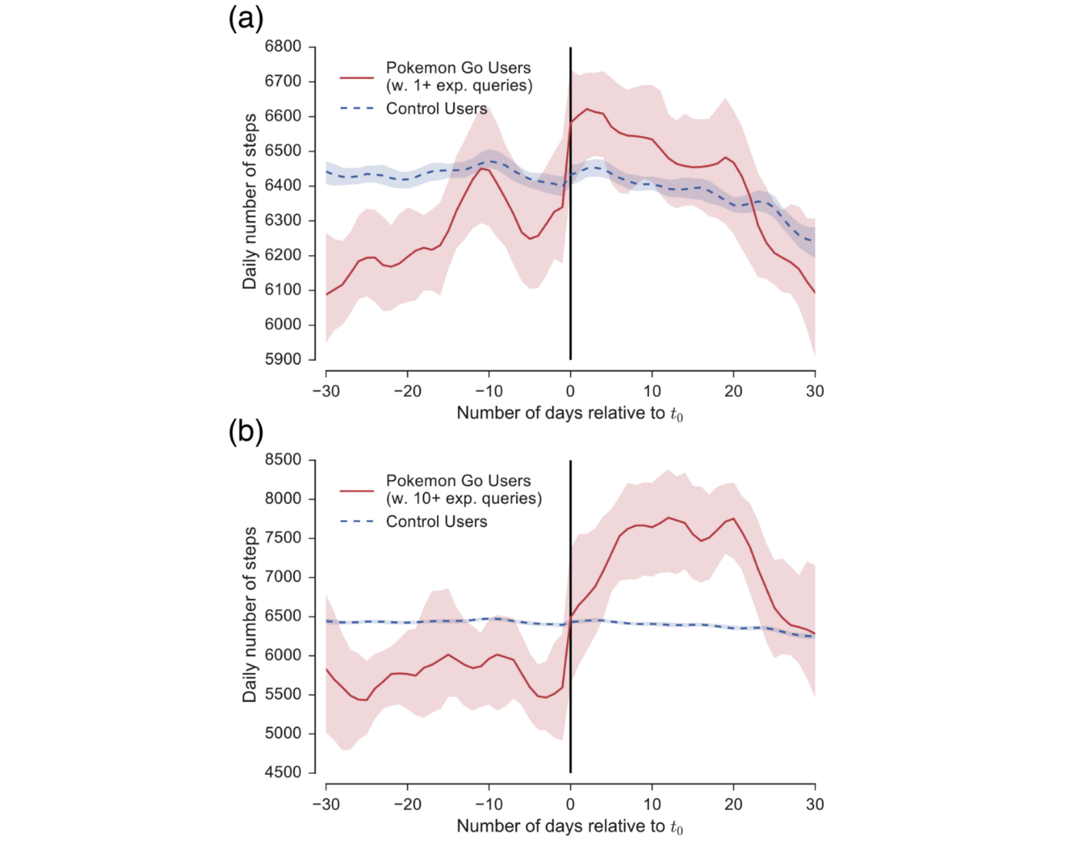
Longitudinal Analysis(1)

Slide 21
Longitudinal Analysis(2)
Control group slightly decreased their activity by 50 daily steps on average
Pokémon Go users increased their activity by 192 daily steps
Activity increases were larger for Pokémon Go users with at
least ten experiential queries
Post Pokémon Go, increase in activity to an average of 7229 daily steps( vs 6435 daily steps in the control group) was observed
Physical activity dropped for both Pokémon Go user groups again after about 3 to 4 weeks from t0

Slide 22
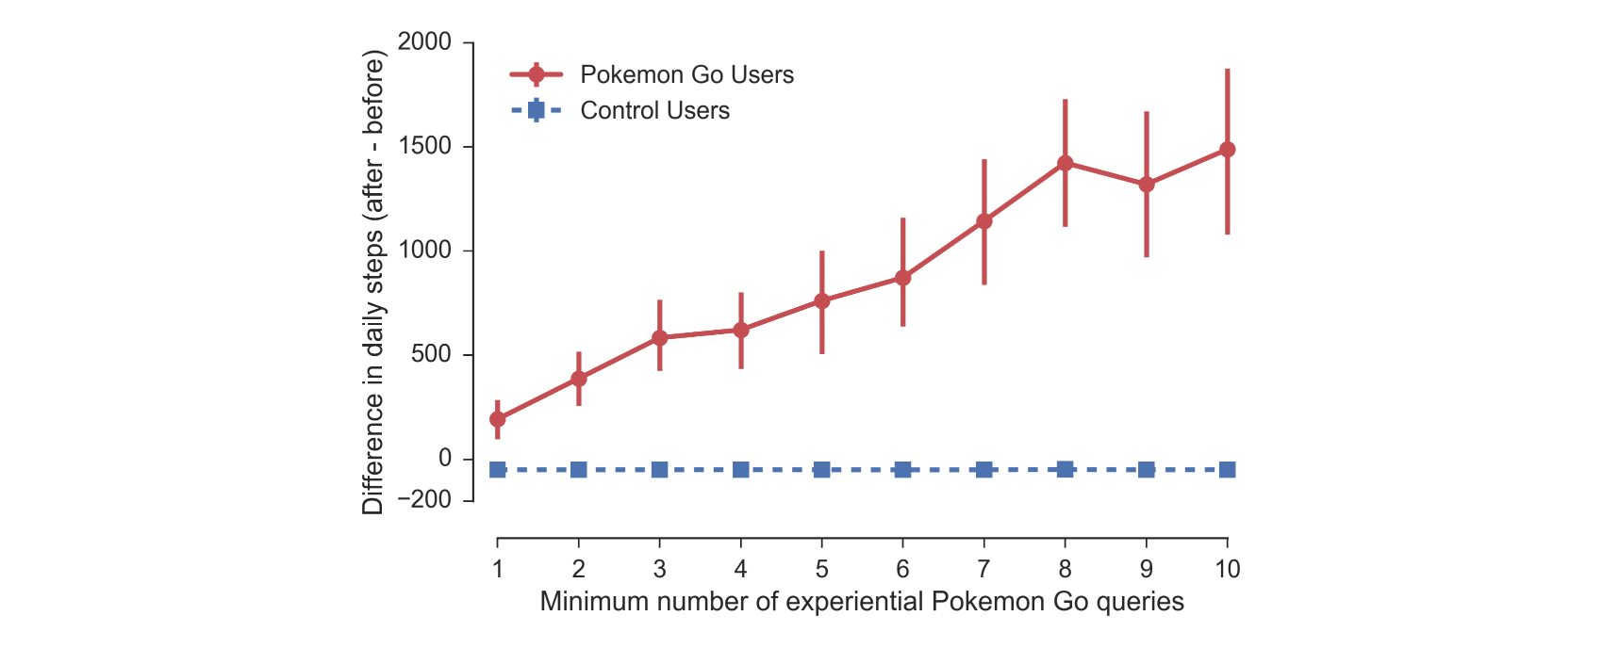
Dose-Response Relationship
Users with more experiential queries for Pokémon Go exhibited increases in physical activity
192 daily steps (3%) )for users with 1+ experiential queries. 1473 daily steps (26%) ) for users with 10+ queries.

Slide 23
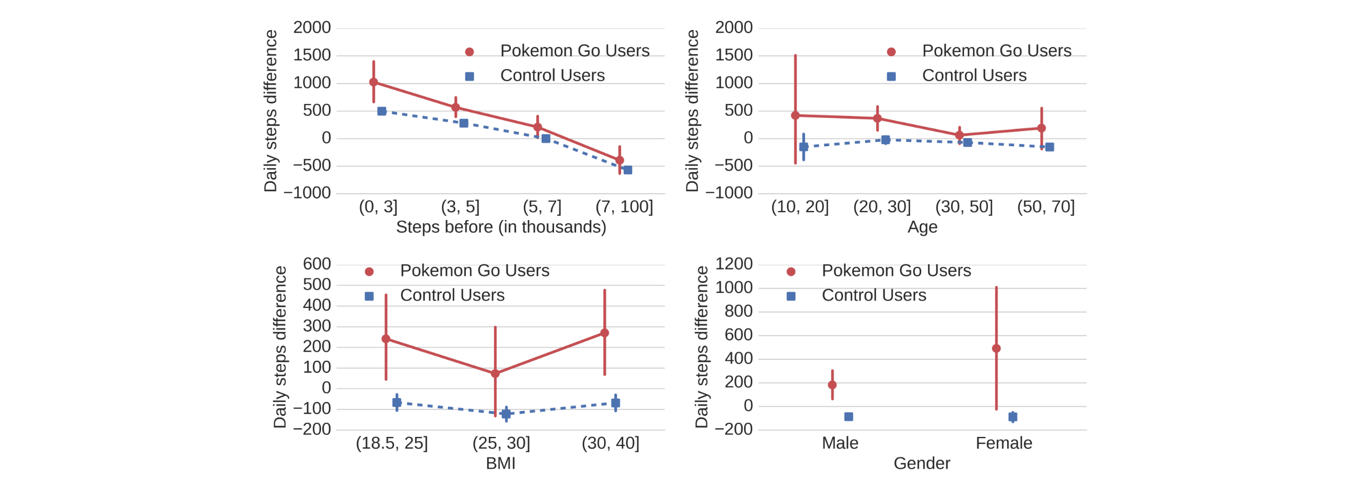
Does Everyone Benefit?
Pokémon Go users (red) exhibit larger changes than their
respective control group (blue)
Physical activity increases due to Pokémon Go is widely spread across the overall study population

Slide 24
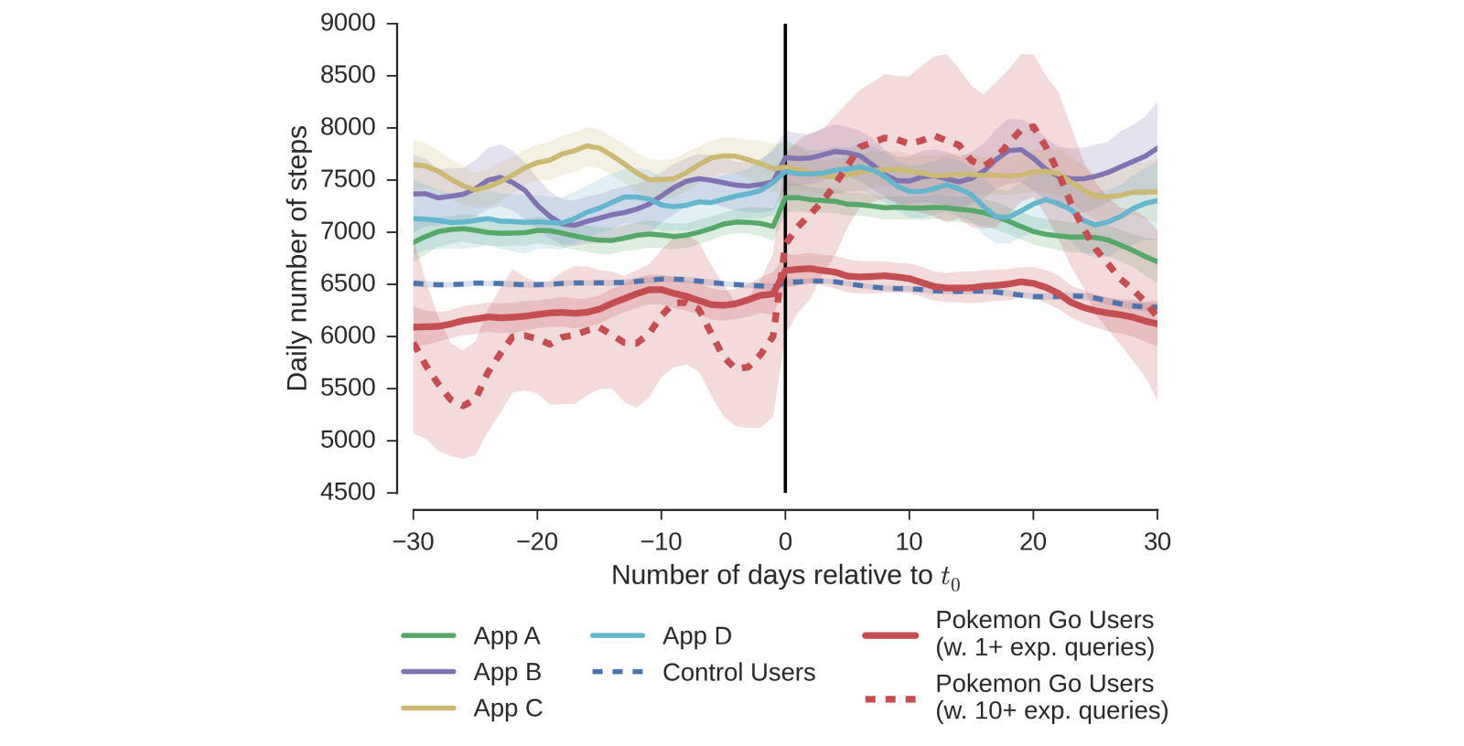
Comparison With Existing Health Apps
Users of all 4 health apps were active than the average wearable user before the app usage.
One exception - app A - 111 daily steps V (vs 192 )

Slide 25
Public Health Impact of Pokémon Go
Effect on US Physical Activity-
increase in physical activity by 192 steps a day.
25 million Pokémon Go users added 144 billion steps within the first 30 days
Effect on Meeting Activity Guidelines-
22.0% before vs 21.9% after t0 - Users with 1+ queries
12.2% before vs 31.7% after t0 - Users with 10+ queries
Effect on Life Expectancy-
age group -> 15-49 years - 41.4 days of additional life expectancy
25 million US Pokémon Go users - 2.825 million years additional life

Slide 26
Principal Findings

Slide 27
Principal Findings
Pokémon Go has lead to increased physical activity, spending more time outside, and exploring the neighborhood, social interactions, and mastering game challenges.
Raised concerns such as injury, abduction, trespassing,
violence, and cost.
Reached all studied populations including low activity populations.
Gives the promise of game-based interventions.

Slide 28
Limitations

Slide 29
Limitations
Study data set was US centric.
Sample of Pokémon Go users is predominantly male.
Use individuals search queries as a proxy for playing Pokémon Go.
Consider the number of queries as indicating the degree
of engagement.
Only Microsoft Bing search results useage.
Follow-up period is currently restricted to 30 days.

Slide 30
Conclusion

Slide 31
Conclusions
Mobile games that require players to physically move in
the real world appear to be an effective and are able to
reach millions of engaged users.
Pokémon Go increased the average activity by 1473 steps a day.
Game has already added an estimated 144 billion steps to US physical activity.
If engagement with Pokémon Go could be sustained
over the lifetime of its many users, we estimate that the game would add an estimated 2.825 million years of additional lifetime to its US users

Slide 32
Other interesting Outcomes
Impact of Pokemon Go: Study in Hong Kong
Weight Loss due to Pokemon Go
Pokemon Go Accident
Couples sue Pokemon Go creator
Pokemon Go fans travel here
Pokemon Go Nature Showcase
Rapid decline in Pokemon Go

Slide 33
Thank You

