Slide 1
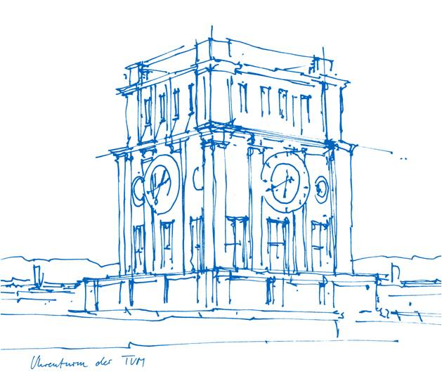
On the privacy-conscientious use of mobile phone data - Montjoye et al.
Julian Schmitz
Technical University Munich
Seminar - Internet of People
Munich, 16. May 2019

Slide 2
Outline
Mobile phone data
Privacy Concerns
Privacy-conscious models
Conclusion

Slide 3
What is mobile phone data?
Where calls are made from and where they are received
Which antenna they were connected to
Focusing on Carrier information

Slide 4
What is mobile phone data?
Where calls are made from and where they are received
Which antenna they were connected to
Focusing on Carrier information
Not: your favourite games, web history, …
GPS
Accelerometer

Slide 5
Attractiveness of mobile phone data
Mobile phone penetration rates > 90% ^{[1]}
Cheap data source (developing countries) ^{[2]}
[1] International Telecommunication Union. The World in 2014: ICT Facts and Figures (2014).
[2] Jerven, M. Poor Numbers: How We Are Misled by African Development Statistics and What To Do About It. (Cornell University Press, 2013).

Slide 6
Use of mobile phone data
City planning ^{[3]}
Location of antennas and base stations ^{[3]}
[3] https://www.economist.com/leaders/2014/10/23/call-for-help

Slide 7
Use of mobile phone data
City planning ^{[3]}
Location of antennas and base stations ^{[3]}
Population Displacement ^{[4]}
Disasters ^{[4]}
Epidemiology ^{[4]}
[3] https://www.economist.com/leaders/2014/10/23/call-for-help
[4] https://www.ncbi.nlm.nih.gov/pubmed/21918643

Slide 8
Bengtsson L, Lu X, Thorson A, Garfield R, von Schreeb J (2011) Improved Response to Disasters and Outbreaks by Tracking Population Movements with Mobile Phone Network Data: A Post-Earthquake Geospatial Study in Haiti. PLOS Medicine 8(8): e1001083. https://doi.org/10.1371/journal.pmed.1001083
https://journals.plos.org/plosmedicine/article?id=10.1371/journal.pmed.1001083

Slide 9
Estimates of the proportion of persons who had left PaP by February 17, per province.
Bengtsson L, Lu X, Thorson A, Garfield R, von Schreeb J (2011) Improved Response to Disasters and Outbreaks by Tracking Population Movements with Mobile Phone Network Data: A Post-Earthquake Geospatial Study in Haiti. PLOS Medicine 8(8): e1001083. https://doi.org/10.1371/journal.pmed.1001083
https://journals.plos.org/plosmedicine/article?id=10.1371/journal.pmed.1001083

Slide 10
But!
Who of you wants to give me your:
Location data
Call history

Slide 11
But!
Who of you wants to give me your:
Location data
Call history
Mobile phone data contains sensitive, private data

Slide 12
Mobile phone data
Privacy Concerns
Privacy-conscious models
Conclusion

Slide 13
Existing Frameworks
developed for data such as census, household survey, and tax data ^{[5]}
An agreed upon set of models has been missing so far for mobile phone data ^{[6]}
[5] http://www.sciencemag.org/news/2014/05/how-two-economists-got-direct-access-irs-tax-records
[6] https://dspace.mit.edu/handle/1721.1/92821

Slide 14
Anonymization
k-anonymity
pseudonymization
de-identification

Slide 15
Anonymization
k-anonymity
1 of k
pseudonymization
de-identification

Slide 16
Anonymization
k-anonymity
1 of k
pseudonymization
John Doe -> AX7
de-identification

Slide 17
Anonymization
k-anonymity
1 of k
pseudonymization
John Doe -> AX7
de-identification
Max Mustermann -> ******

Slide 18
What’s your k (-anonymity)?
Garching
Your uni schedule
Your home
Your parents, friends, hobbies

Slide 19
What’s your k (-anonymity)?
Garching
Your uni schedule
Your home
Your parents, friends, hobbies
k = the people that accompany you all the time

Slide 20
Is that enough?
Four data points - approximate places and times where an individual was present - have been shown to be enough to uniquely re-identify them 95% of the time in a mobile phone dataset of 1.5 million people ^{[7]}
[7] https://www.ncbi.nlm.nih.gov/pubmed/23524645

Slide 21
Is that enough?
Four data points - approximate places and times where an individual was present - have been shown to be enough to uniquely re-identify them 95% of the time in a mobile phone dataset of 1.5 million people ^{[7]}
Low unicity (unique traces)
failed attempts to k-anonymize mobile phone data ^{[8]}
-> current methods not sufficient for mobile phone data
[7] https://www.ncbi.nlm.nih.gov/pubmed/23524645
[8] https://arxiv.org/abs/1501.00100

Slide 22
Ebola crisis
Researchers were prevented from accessing relevant mobile phone data on time with privacy being cited as one of the main concerns. ^{[9]}
[9] https://www.economist.com/leaders/2014/10/23/call-for-help

Slide 23
Mobile phone data
Privacy Concerns
Privacy-conscious models
Conclusion

Slide 25
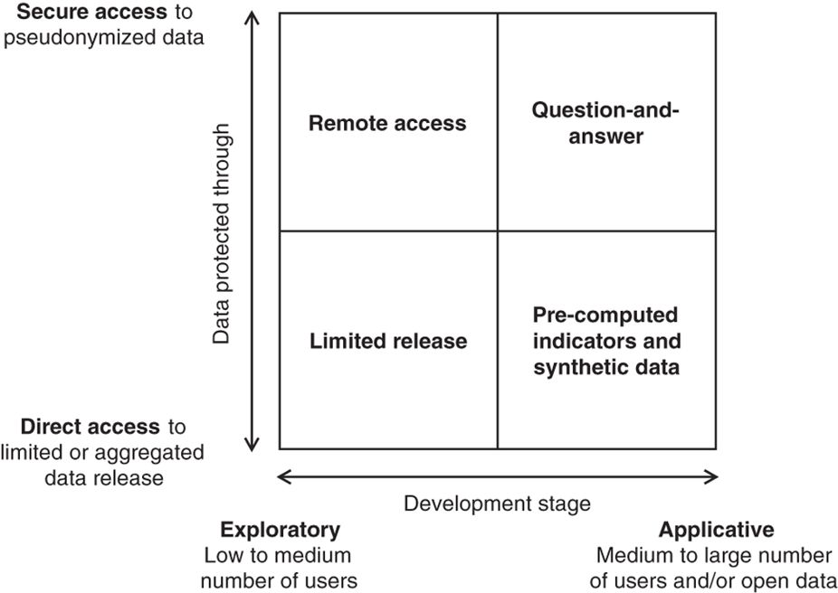
Limited release
is the closest model to traditional sharing of data.
Transform data to limit re-identification

Slide 26
Limited release
is the closest model to traditional sharing of data.
Transform data to limit re-identification
Tradeoff with statistical power of the data set
Still identifiable -> Need for non-disclosure and data use agreements (DUA)

Slide 27
Limited release
is the closest model to traditional sharing of data.
Transform data to limit re-identification
Tradeoff with statistical power of the data set
Still identifiable -> Need for non-disclosure and data use agreements (DUA)
Use case: The D4D-Senegal challenge is an open innovation data challenge on anonymous call patterns of Orange's mobile phone users in Senegal. The goal of the challenge is to help address society development questions in novel ways by contributing to the socio-economic development and well-being of the Senegalese population. ^{[10]}
[10] https://arxiv.org/abs/1407.4885

Slide 28
Pre-computed indicators and synthetic data
To release indicator data without restrictions on users or
access.
Individual (e.g. number of calls)
Aggregated (e.g. number of users per tower)

Slide 29
Pre-computed indicators and synthetic data
To release indicator data without restrictions on users or
access.
Individual (e.g. number of calls)
Aggregated (e.g. number of users per tower)
Better anonymization possible
Threat: Can reveal data on (minority) groups -> group privacy

Slide 30
Pre-computed indicators and synthetic data
To release indicator data without restrictions on users or
access.
Individual (e.g. number of calls)
Aggregated (e.g. number of users per tower)
Better anonymization possible
Threat: Can reveal data on (minority) groups -> group privacy
Use case: Ebola population flow maps ^{[11]}, Tourism statistics ^{[12]}
[11] https://www.ncbi.nlm.nih.gov/pmc/articles/PMC4205120/
[12] https://www.itu.int/en/ITU-D/Statistics/Documents/events/wtis2014/002INF-E.pdf

Slide 31
Remote access
Data stay within the premises and under the control of the
operator
Only aggregated data leave the secure area, monitoring

Slide 32
Remote access
Data stay within the premises and under the control of the
operator
Only aggregated data leave the secure area, monitoring
Limits the risk of data to be re-identified en masse
Less transformation necessary -> more statistical power kept

Slide 33
Remote access
Data stay within the premises and under the control of the
operator
Only aggregated data leave the secure area, monitoring
Limits the risk of data to be re-identified en masse
Less transformation necessary -> more statistical power kept
Threat: targeted users re-identified
Use case: Near real-time data for highly-trusted third-parties with DUA (Nepal earthquake) ^{[13]}
[13] http://www.flowminder.org/case-studies/nepal-earthquake-2015

Slide 34
Question-and-answer
Privacy through security
Third-parties may only send queries, never see the underlying
data

Slide 35
Question-and-answer
Privacy through security
Third-parties may only send queries, never see the underlying
data
Fully log queries and answers
Constrain that k individuals contribute to each answer

Slide 36
Question-and-answer
Privacy through security
Third-parties may only send queries, never see the underlying
data
Fully log queries and answers
Constrain that k individuals contribute to each answer
Threat: Server being compromised (holds for all other models as well, low risk)
Use case: medium to high numbers of third-parties in near real or real time

Slide 37
Mobile phone data
Privacy Concerns
Privacy-conscious models
Conclusion

Slide 38
Conclusion
Mobile phone data has a great potential for good
high dimensionality limits the applicability of traditional data anonymization methods
These four models might help to properly balance technically
the need to use this data for good
the legitimate privacy concerns of individuals and societies.

Slide 39
What social problems can be dealt with through the analysis of this type of data?
The main problems that are studied are related to social questions (segregation in cities, improving public transport in cities, recommending places to visit, detecting events), economic issues (detecting economic indicators, poverty, unemployment, underground economy, geomarketing), safety problems (crime, prevention or management of emergency situations) or issues related to health. ^{[14]}
[14] https://phys.org/news/2015-04-analysis-mobile-economic-social-problems.html

Slide 40
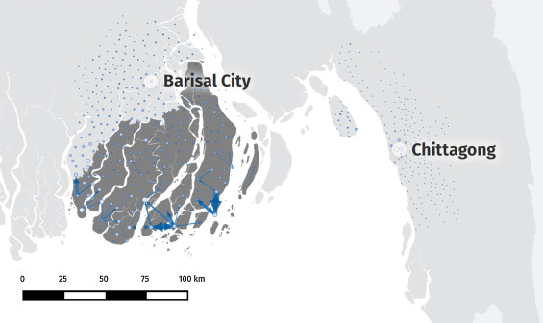
Mobile Phone Data to Understand Climate Change and Migration Patterns in Bangladesh
High-risk mobility of mobile phone users during cyclone landfall and passing^{[15]}
[15] http://www.flowminder.org/case-studies/mobile-phone-data-to-understand-climate-change-and-migration-patterns-in-bangladesh

