Slide 1
“The Spread of Physical Activity Through Social Networks”
David Stück, Haraldur Tómas,Greg Ver Steeg, Alessandro Epasto, Luca Foschini

Slide 2
Outline
Introduction
Related Work
Methodology
Results
Conclusion

Slide 3
Introduction
40% of premature deaths in U.S. attributed to behavior/ lifestyle
U.S. adult obesity rate increased from 25.5% - 27.7% in 6 years.
Body weight abnormalities cost 21% of annual medical spending
Objective: observing behavior in others impact on one’s own behavior
Contribution : Track physical activity of 44.5K users on social network (Fitbit) for a year
Between-subject analysis ( more friends = more activity )
Within-subject analysis (relation between social network & physical activity )
Causality test on network over time (activity explained by homophily)

Slide 4
Related Work
Before mHealth (mobile Health) technologies, physical activity was self-reported, limiting studies
IoT made available large dataset where social - physical interaction are tracked electronically.

Slide 5
Methodology: Data Collection
Dataset: 44,468 members of Achievemint observed over 1 year. (7,515 with chronic condition)
Members link their Fitbit app by authorizing their data to be used by the platform.
For every new activity reported earn points (after 1,000 points = $1.00)
Inclusion criteria:
Achievemint members with at least 7 days of activity recorded
500 - 40,000 daily average steps

Slide 6
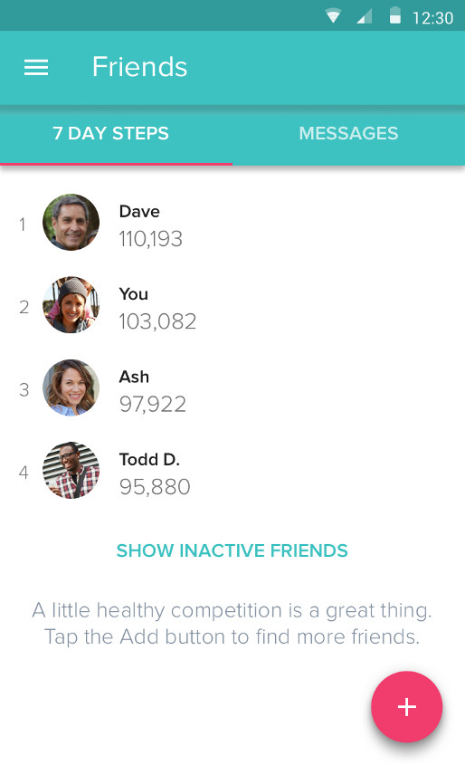
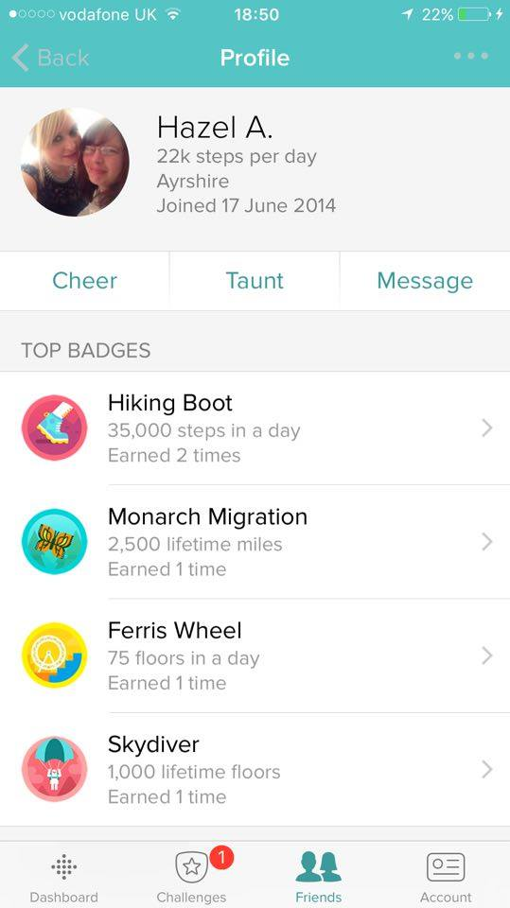
Methodology: Data Collection
Social interaction:
Display total step count over last 7 days ranked
Users gain trophies for achieving milestones

Slide 7
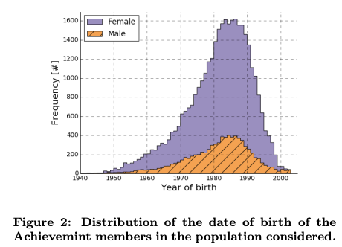
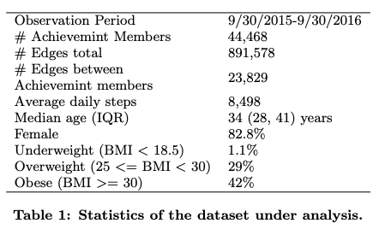
Methodology: Network Analysis Statistics

Slide 8
Methodology: Network Analysis Statistics

Slide 9
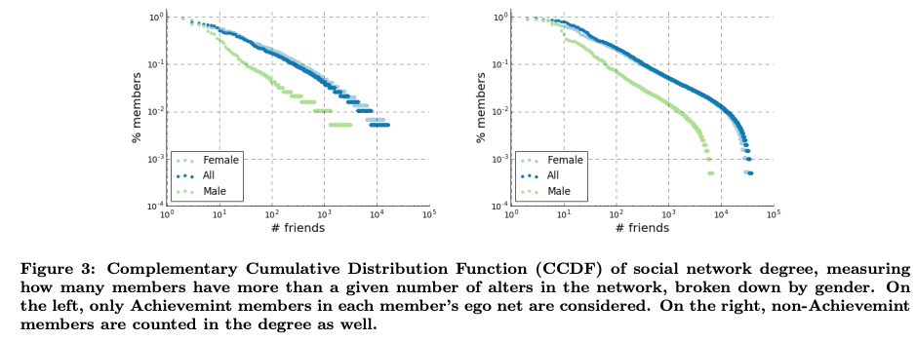
Methodology: Network Analysis Statistics

Slide 10
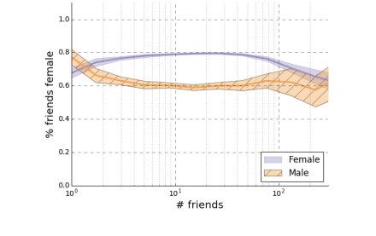
Methodology: Network Analysis Statistics
Gender Homophily (ties with members of same gender)
Observation: Proportion of female ties for female members is higher than of male members.
Validation:
Define null-model and uniform distribution
Apply Monte Carlo simulations in multigraph sampling to obtain an empirical p-value
Use significance level to calculate the probability based on p-value distribution

Slide 11
Methodology: Network Analysis Statistics
G = (V, E) graph representing social network for a member u ϵ V, let :
a (u) = Achievemint membership status
s (u) = gender
da (u) =connection w/Achievemint membership
dn (u) = connection w/non-Achievemint membership
Let H=( V, E’ ) multigraph over the same set of nodes (V) where S(H) represent ties between same gender users (null-model) following a uniform distribution
|E| = |E’| (number of edges)
Results:
70.1% same gender edges observed in dataset vs. 66.4% expected by null-model
Dataset has significantly gender homophily

Slide 12
Methodology: Between-subject analysis
Define physical activity of a member as a function of features. (age, gender, BMI)
Dataset: Average 209 days of activity over 1 year
Method: Regressing average ego activity based on age, BMI, gender, size of alters across the network and average alters activity (connections).

Slide 13
Methodology: Between-subject analysis
Results:
Lower BMI correlates to higher activity
Users with highly active contacts tend to have higher activity
Ego’s activity increase on average: 26 steps (for each additional 100 alter steps)
6.5 daily steps for each additional social tie
For an additional alter average BMI point ego’s activity increase by 14.1 steps

Slide 14
Methodology: Between-subject analysis
Interactions of chronic conditions
Regression model concludes:
hypertension: decrease in activity compared to other without the condition
diabetes: interaction increases by 31.1 steps per new tie w/same condition
depression : increases by 9.3 steps per new tie w/same condition

Slide 15
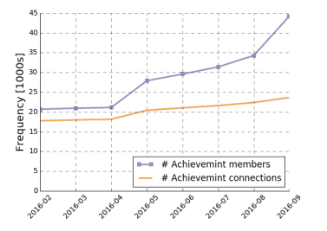
Methodology: Within-subject analysis
Model association between member’s activity and features of the network over time.
Changes in ego network driven by addition/removal of social ties.
More members → increase size of the network
(just Achievemint members)
Both Achievemint and non-Achievemint members → 479 thousand new edges added to network

Slide 16
Methodology: Within-subject analysis
Results:
Users with higher activity more likely to add new friends
Expanding one’s social network increases activity due to social interaction
Adding “fresher” users has positive impact in ego activity.

Slide 17
Methodology: Causal Influence
Analysis of network over time to identify the role of social influence vs. homophily
At = Activity at time t
At-1 = Previous state
RA = Latent traits
E = Edge
Activity depends on the latent traits and previous actions
Results: relative strength of contagion (“influence”) cannot be determined, but it is possible to rule out the possibility of correlations arising only from latent homophily

Slide 18
Methodology: Causal Influence
Using algebraic geometry approach to discard the possibility that all correlations are due to latent homophily
A = Alice B = Bob t= {1, .., T}
Method: Probability distribution over their observed activities when tie occurs:
Markov assumption => transition probabilities do not change over time

Slide 19
Methodology: Causal influence
Represent it using a probability distribution in a dimensional space.
Structure of space represented as :
Use linear programming (LP) to calculate the tightness between bonds determined by a maximum degree to guarantee:

Slide 20
Methodology: Causal Influence - Data Preparation
Model social influence between Achievemint members connected on Fitbit network for activity level and BMI.
Activity influence among friends (ACT):
binarize monthly changes (greater / less) than threshold
threshold = median change for that month
Model BMI changes:
Changes in BMI (increase / decrease) relative to the median
median of BMI if that month

Slide 21
Methodology: Causal Influence - Results
Empirical distribution:
Linear test:
Rule out the hypothesis that data dependencies are caused only by latent homophily

Slide 22
Limitations of the Analysis
Rejection of null model due to Markovian dynamics
Relies on assumptions such as stationary Markovian dynamics (transition probabilities do not change over time)
Reported/ updated data may be affected by influence instead of actual BMI changes

Slide 23
Conclusion
Show relationship between a social network and physical activity of 44.5K Fitbit users.
Confirm the significance of associations between ego - alters activity over time.
Existence of external causes that change egos and alters activity cannot be rule out.
Each additional tie = increase of 6.5 steps egos activity
For each 100 steps in alters daily activity = ego walks 26 additional steps per day
Chronic users revealed positive association of alter’s - ego’s activity

Slide 24
Future work:
Focus on better understanding the causal factor causing changes in physical activity due to external factors and quantify how sustainable are such changes over time, including user motivation and retention
Contribution/Goal:
Help to understand which features and mechanisms of an online social network are most successful at promoting healthy habits among members

