Slide 1
Sustainability in HPC: Vision and Opportunities
Mohak Chadha¹, Eishi Arima¹, Amir Raoofy²,
Michael Gerndt¹, Martin Schulz^{1,2}
¹ Technische Universität München (TUM)
² Leibniz-Rechenzentrum (LRZ)

Slide 2




Executive Summary
We will discuss potential solutions to reduce the carbon footprint of supercomputers from various perspectives (this is a position paper)
  Carbon Emission = Direct (Scope 1) + Indirect (Scope 2/3)
  Scope 2: Operational Carbon
  Scope 3: Embodied Carbon
Component (or Chip) Design
Carbon Reduction
System Design & Procurement
Scope 2
Scope 3
Dynamic Power Bound Scaling
Dynamic Resource Scaling
Scheduling & Checkpointing
Making HPC Users Greener
System Lifetime, Reuse, & Recycle

Slide 3
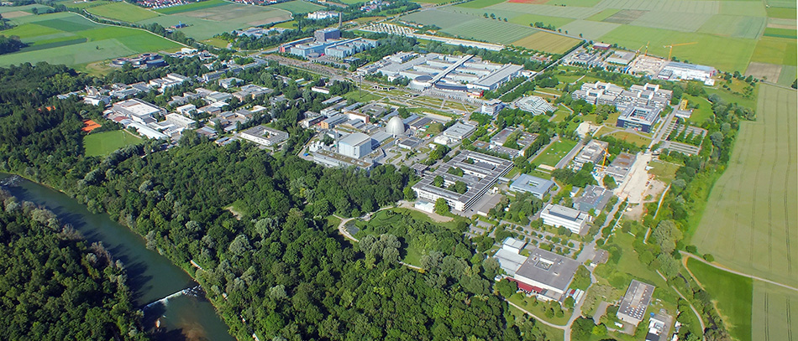
Outline
Background
Reducing Embodied Carbon (Scope 3)
Reducing Operational Carbon (Scope 2)
Conclusion & Acknowledgement

Slide 4
Outline
Background
Reducing Embodied Carbon (Scope 3)
Reducing Operational Carbon (Scope 2)
Conclusion & Acknowledgement

Slide 5

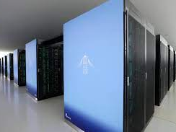



Needs for Carbon-awareness in Supercomputing
Supercomputers indirectly account for a tremendous amount of carbon emissions
  Mainly due to the scale: (1) consist of over 100K of components; (2) consume few 10s MW of power
Need to limit their carbon emissions while following the GHG (Green House Gas) protocol
Carbon
Awareness
Fugaku
0.44Exa @30MW
Frontier
1.2Exa @23MW
Aurora
2Exa? @60MW?
Future Green Supercomputers
(Image generated by deep AI)

Slide 6
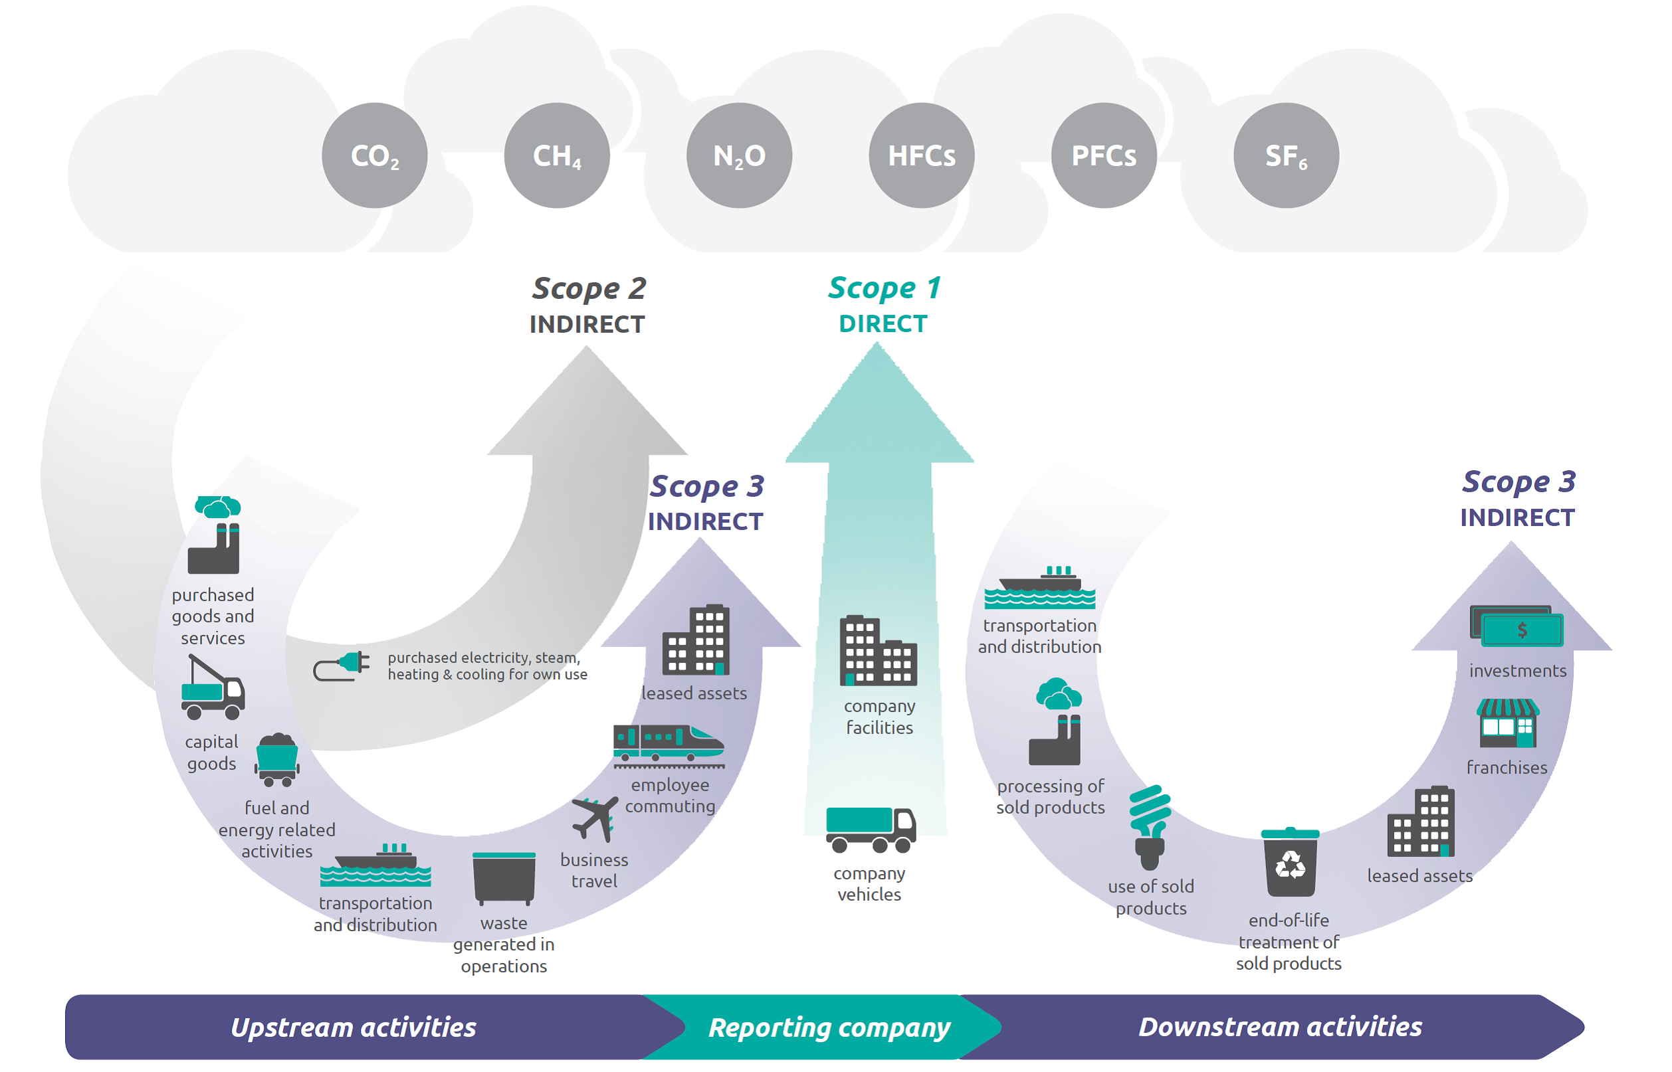
The GHG Protocol
Scope 1: Relevant if fossil fuels are burnt on site (usually not the case)
Scope 2: Electricity, heating, cooling, etc. for the site operation
Scope 3: The other indirect emissions, e.g., production, shipping, and disposal of system components
Our Focus
Source: https://ghgprotocol.org/sites/default/files/standards/Corporate-Value-Chain-Accounting-Reporing-Standard_041613_2.pdf

Slide 7
Outline
Background
Reducing Embodied Carbon (Scope 3)
Reducing Operational Carbon (Scope 2)
Conclusion & Acknowledgement

Slide 8
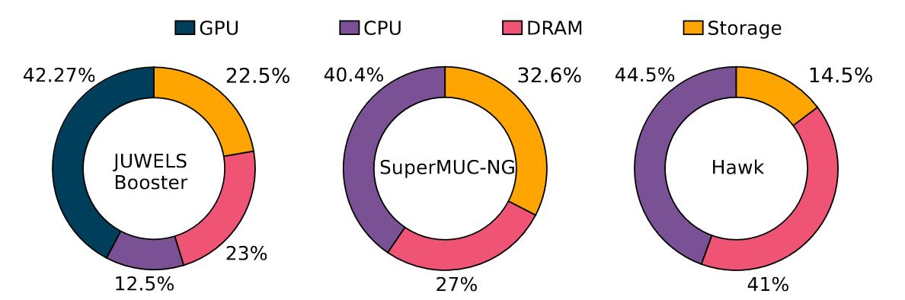
Reducing Embodied Carbon (Scope 3)
Embodied carbon consists of production, transportation, & disposal
  The production part (manufacturing + packaging) is dominant [U. Gupta+ ISCA’22]
  The embodied carbon trend differs across different systems
    The system architecture & procurement (incl. product choices for components) matter
Promising Approaches for Embodied Carbon Reduction:
  Carbon-aware Component Design
  Carbon-aware System Architecture & Procurement
  System Lifetime Extension & Reuse/Recycling
Estimated Embodied Carbon Footprint Breakdowns
Calculated based on a prior study [B. Li + SC’23]

Slide 9
Designing Carbon-efficient HPC Components
Carbon-aware Chip Design:
max Perf(W, d)
s.t. Pow(W, d) ≤ Pow_{Target}
Cost(d) ≤ Cost_{Target}
EmCrbn(d) ≤ EmCrbn_{Target}
OpCrbn(W, d, CI) ≤ OpCrbn_{Target}
d ∈ D
In: W, CI, Out: d_{opt} (∈ D)
Hierarchical Optimization for 2.5D/3D Integrations:
Conventional Chip Design:
max Perf(W, d)
s.t. Pow(W, d) ≤ Pow_{Target}
Cost(d) ≤ Cost_{Target}
d ∈ D
In: W, Out: d_{opt} (∈ D)
Chiplet A for W_{X}
Chiplet A for W_{X}
Chiplet A for W_{X}
Chiplet A for W_{X}
Chiplet A for W_{X}
Chiplet A for W_{X}
Chiplet A for W_{X}
Chiplet A for W_{X}
Chiplet A for W_{X}
Chiplet A for W_{X}
Chiplet B for W_{y}
Chiplet C for W_{z}
2.5D/3D Packaging
W: Target workloads or proxy apps
D: A set of design points to explore
d (∈ D): A set of design parameters
X_{Target}: Target value for metric X
EmCrbn/OpCrbn: Embodied/operational carbon
CI: Typical carbon intensity of the target system
Alternative design goals [U. Gupta+ ISCA’22]:
Carbon-delay product
Carbon-delay² product
Embodied Carbon in Production
≃ Manufacturing + Packaging
Both inter- and intra-chiplet optimizations matter!
* inter: manufacturing part, intra: packaging part

Slide 10
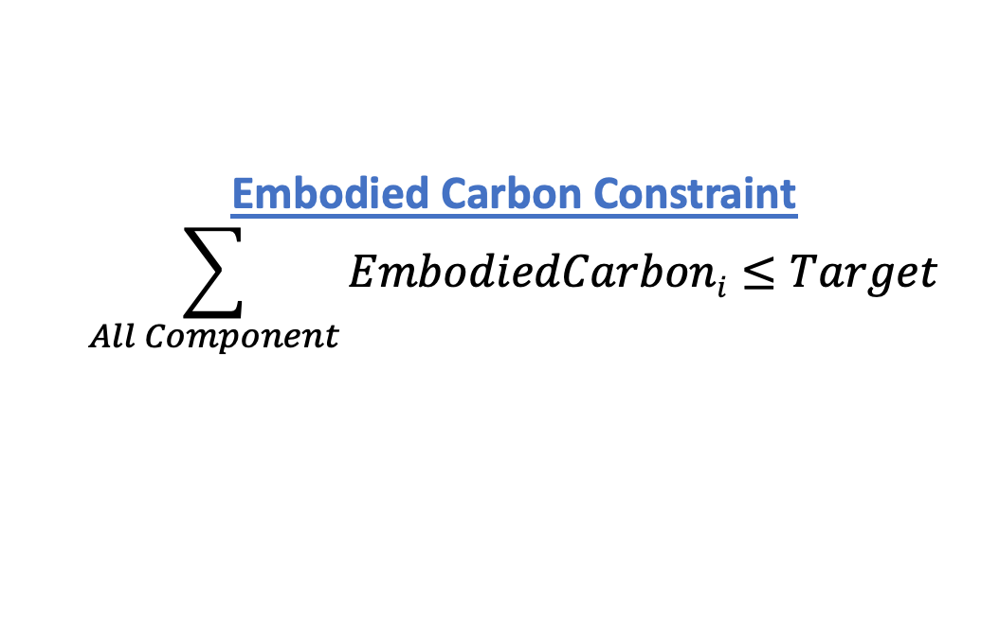
System Architecture and Procurement
System Optimization
Goal: Max SystemThroughput(Workloads)
Constraints:
Budget = MachineCost + Electricity;
SystemFootprint; SystemWeight;
CoolingCapacity; PowerSupply
New Constraint: CarbonBudget
Embodied Carbon Constraint
$$\sum_{All Component}{EmbodiedCarboni≤Target}$$
Best in Performance
The optimal system design will change by taking carbon into account!
The decision will be even harder due to the emerging architectures/devices!
CPUA
GPUA
. . . .
MemA
Perf: 2, Pow: 1
Cost: 1, EC: 2
Total Carbon Budget
CPUB
GPUB
MemB
. . . .
Embodied Carbon Budget
+
Operational Carbon Budget
Perf: 1.5, Pow: 1
Cost: 1, EC: 1
The same procedure goes for all the other components
Trade-off
∝ System’s Energy Budget
Best in Embodied Carbon
. . . .
. . . .
. . . .

Slide 11
System Lifetime, Reuse, and Recycling
System Lifetime: Typically 4-6 years
  Extending the lifetime will contribute to the embodied carbon reduction (right fig)
Reuse & Recycling: for reducing the carbon emissions in disposal & production
  Reuse: LRZ offers decommissioned machines to other public institutions for free
  Recycling: DRAM chips (DDR4=>DDR5), heat pipes, etc.
Carbon/year
Embodied
Operational
HPC System | Start of Operation | Decommissioned
SuperMUC | 2012 | 2018
SuperMUC Phase2 | 2015 | 2019
SuperMUC-NG | 2019 | 2024
SuperMUC-NG Phase2 | 2023 | –
Year
Longer Lifetime
Carbon/year
4-6yrs
Year

Slide 12
Outline
Background
Reducing Embodied Carbon (Scope 3)
Reducing Operational Carbon (Scope 2)
Conclusion & Acknowledgement

Slide 13
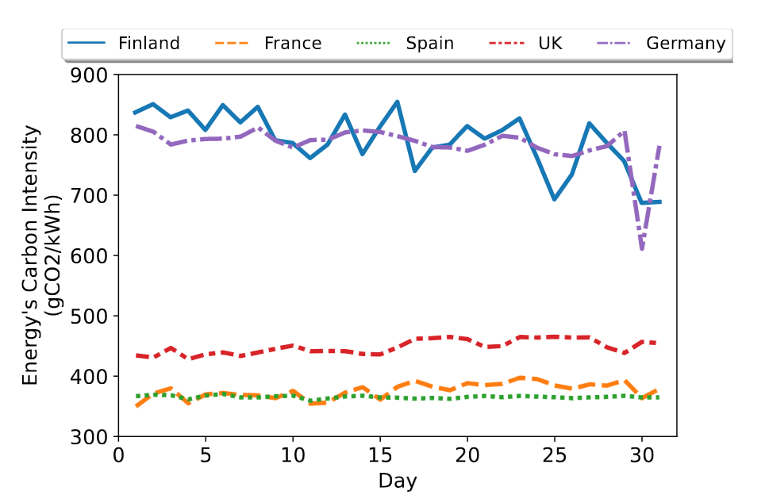
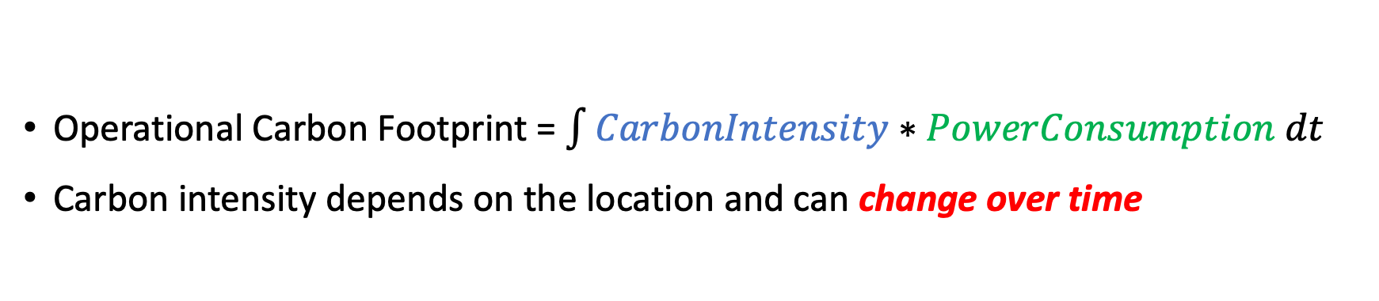
Reducing Operational Carbon (Scope 2)
Operational Carbon Footprint = $\int{CarbonIntensity∗PowerConsumption dt}$
Carbon intensity depends on the location and can change over time
Promising Approaches: Scaling or shifting the following properties in accordance the carbon intensity
  System Power Bound
  System Scale (# of nodes)
  Peak Load
* Existing energy/power reduction techniques generally ignore the carbon intensity

Slide 14
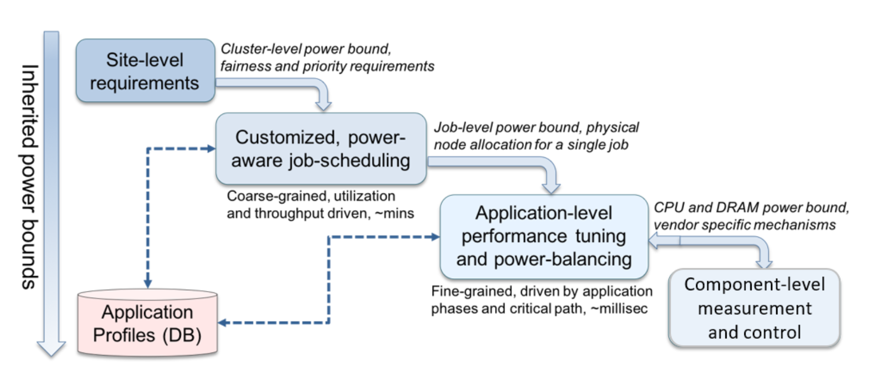
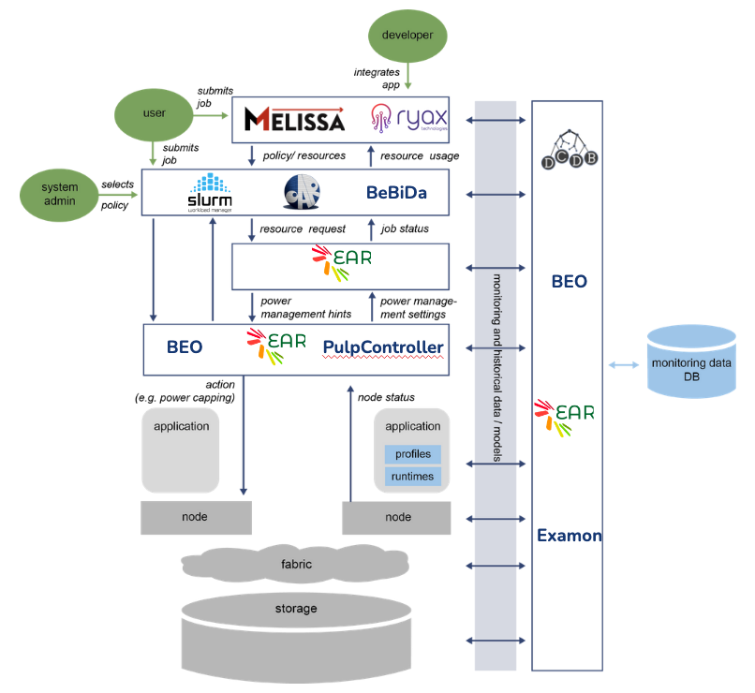

Carbon-aware Dynamic Power Budget Scaling
Hierarchical Power Mgmt
Carbon-aware Dynamic Power Budget Scaling Here
A new use case of HPC PowerStack
Scaling up/down the total system power bound based on the carbon intensity
  Goal: to limit the operational carbon footprint within a given target
https://hpcpowerstack.github.io/
The Concept
Carbon Intensity
System Power Bound
Promissing Solution
High
High
e.g., watttime
Carbon Intensity
or Power Bound
+
Low
https://www.watttime.org/
Low
Time
Carbon Intensity Estimation Tools
REGALE PowerStack

Slide 15



Carbon-aware Dynamic Resource Scaling
Hierarchical/Dynamic Res. & Pow Mgmt
Dynamically adapt the system scale in accordance with the carbon intensity
Change the resource assignments to running jobs – known as malleability
  Should cooperate with power budgeting
Low
Node Power Bound: High
JobA
JobA
JobC
JobC
Off
JobB
JobB
Low Carbon Intensity
High Carbon Intensity
The Concept
Carbon Intensity
Total # of Nodes
Ongoing Efforts toward Malleability Support
Closs Layer Support:
High
Grow
+
PMIx
+
Carbon Intensity
or Total # of Nodes
Shrink
Our Projects:
Low
Time

Slide 16
Carbon-aware Scheduling and Checkpointing
Concept: Adapt the system loads so as to have less jobs/loads when the carbon intensity is higher
Promising Solution: Peak Load Shifting
  Proactive: predict the duration of green (low carbon intensity) period and optimize the scheduling decisions (e.g., green period-aware backfilling)
  Reactive: suspending, checkpointing, and restarting (large) jobs
×
○
Carbon Intensity
System Load
Peak
Shifting
Carbon Intensity
System Load
High
High
Peak
Carbon Intensity
or System Load
Peak
Carbon Intensity
or System Load
Low
Low
Time
Time

Slide 17

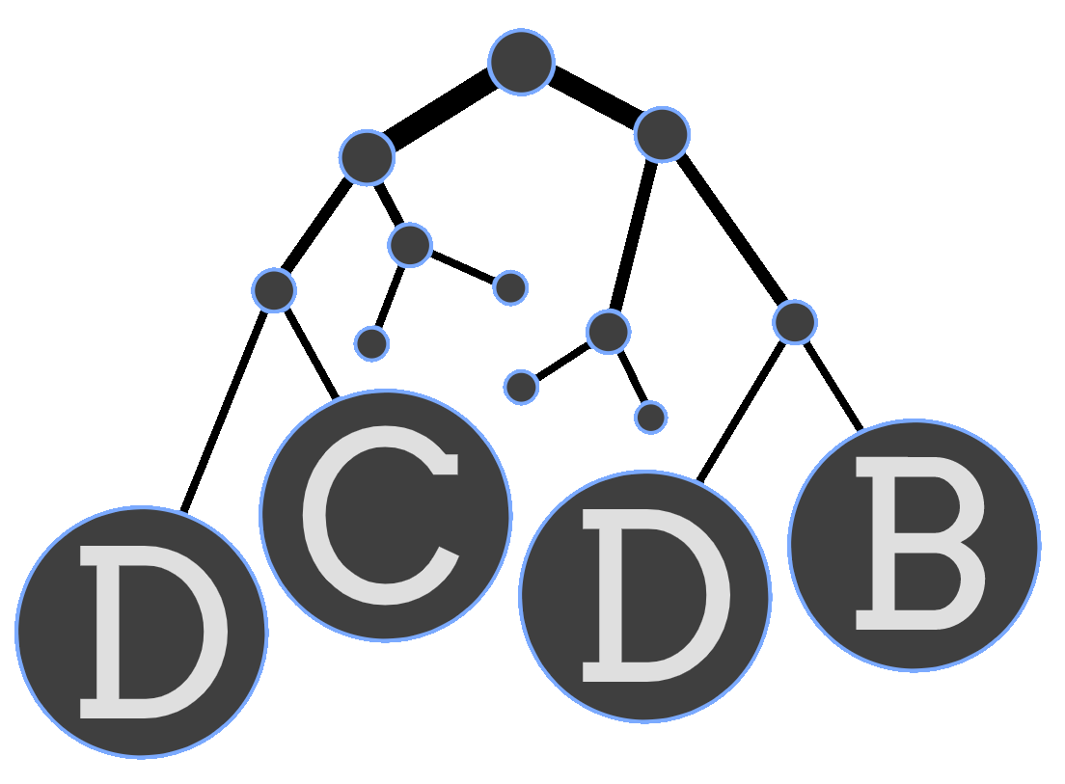
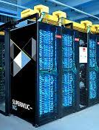



Making HPC Users Greener
Examon
Green Q
System Mngr
Monitor
Users can also contribute to peak shifting & energy footprint reduction
  Peak shifting: by submitting their jobs in a green queue
    Economical & low priority if not in the green period
    Accept power capping, scale shrink, or suspend
  Energy footprint reduction: by job-level optimizations for energy reduction
    Code optimizations, energy-efficient libraries, etc.
Should provide right feedback & incentives to users to make them green
Energy
Efficient
Job
System
Carbon-based accounting
Current HPC: Time is money and money is time
Future HPC: Carbon is money and money is carbon
OMG
–
Feedback/Suggestions
User
Your job accounted for the same amount of CO2 emissions as xxxxx, and as a result it consumed yy% of quota assigned to your project! You could save zz% of the quota consumption by simply following the steps below…

Slide 18
Outline
Background
Reducing Embodied Carbon (Scope 3)
Reducing Operational Carbon (Scope 2)
Conclusion & Acknowledgement

Slide 19
Concluding Remarks
Carbon-aware supercomputing ≠ power-/energy-aware supercomputing!
Embodied Carbon Reduction (Scope 3): Needs an end-to-end carbon-aware optimization from chip to system, and even procurement
Operational Carbon Reduction (Scope 2): Needs (1) adaptive power, resource, & job management, and also (2) green users

Slide 20

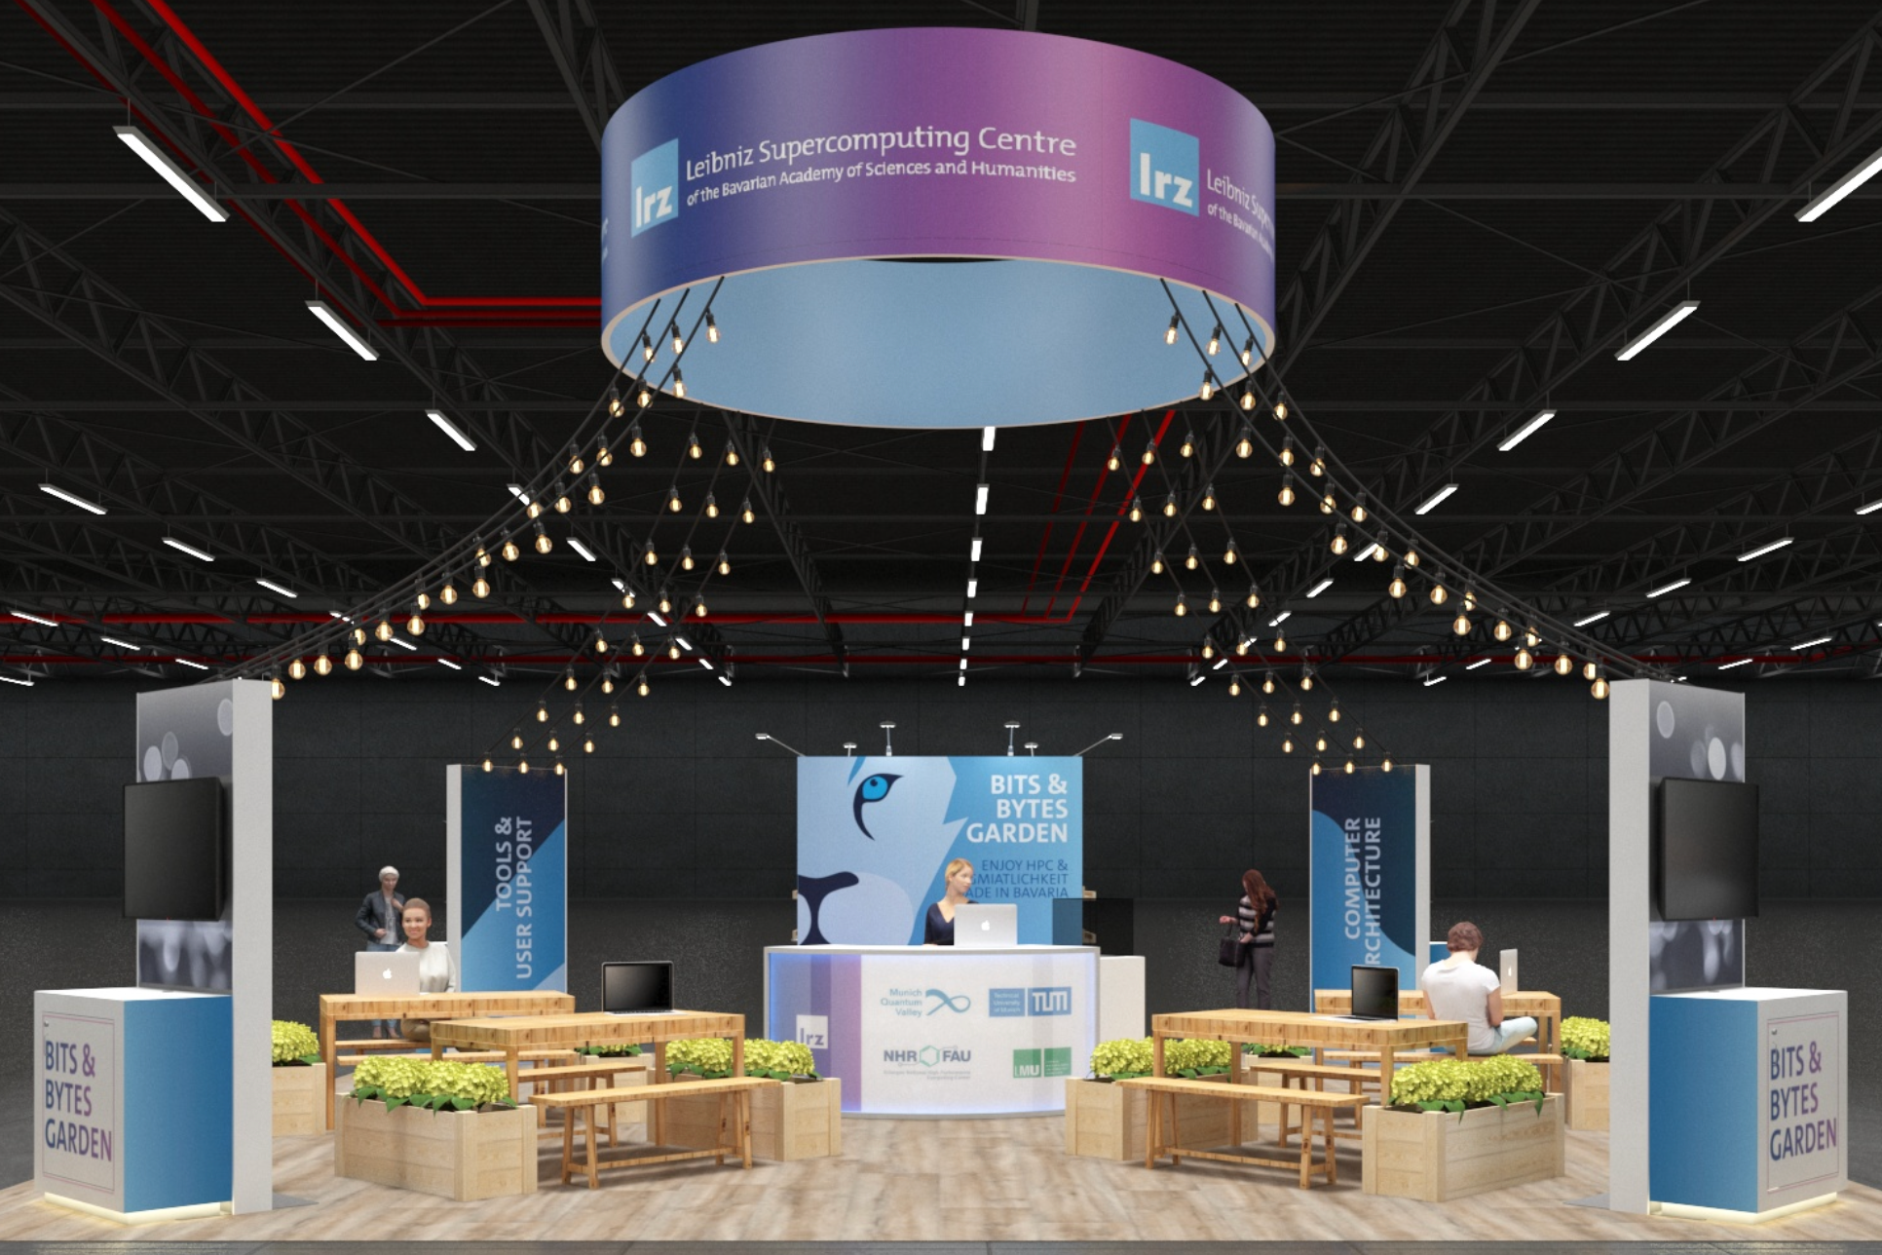
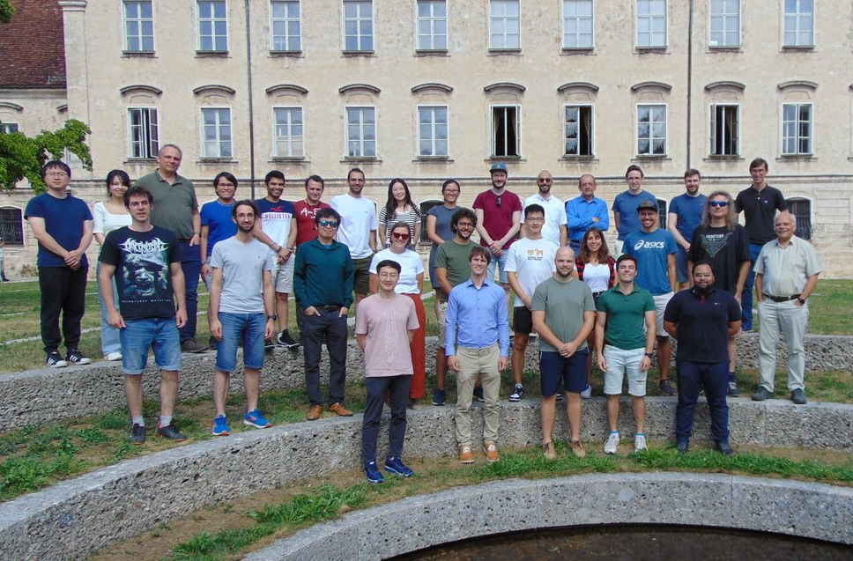



Acknowledgement
This work has received funding under the European Commission’s EuroHPC and Horizon 2020 programmes under grant agreements no. 956560 (REGALE), no. 955606 (DEEP-SEA), and no. 955701 (TIME-X).
Visit our booth (#1311)!
Feel free to contact us!
REGALE
DEEP-SEA
LRZ
Booth
TIME-X
CAPS TUM
CAPS TUM

