Slide 1
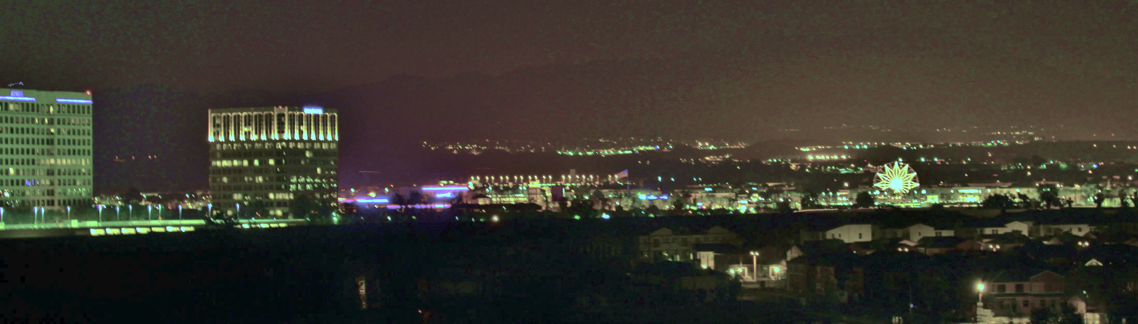


Cache Miss Curve Analysis via Cardinality Domain
Image Source: Wikimedia
Eishi Arima Martin Schulz
Technical University of Munich

Slide 2
Executive Summary
Background: Stack distance is a widely-used concept to represent the temporal locality of applications
  Statistics of unique data access count between two consecutive accesses to the same data
  Ultimately converted into a cache miss curve – miss ratio/frequency vs capacity
Problem: Significant overhead to keep track of the distances (using an LRU stack)
Key Contributions:
  We regard the LRU stack behavior as a series of Bernoulli trials and derive a macroscopical relationship between a cardinality curve and the corresponding miss curve
  We propose an efficient approach to estimate a miss curve without stack distances but using efficient cardinality detection data structures (Bloom filter, HyperLogLog, etc.)
  We focus on the additivity principle in the cardinality domain and offer an algorithm to synthesize the miss curve of a mixed stream using the cardinality info of individual streams

Slide 3
Outline
Background & Literature
Key Insight on Cardinality
Proposed Method
Evaluation
Conclusion

Slide 4
Cache Miss Curve Detection
Problem: For a given address sequence, estimate the cache miss ratio or frequency as a function of cache capacity
  Input: Memory/cache/TLB access trace, web service traffic trace, etc.
  Use cases: Program characterization, early-stage cache/TLB design, cache/TLB partitioning, web cache server design, code optimization, etc.
Size Requirement
The goal is to choose the minimal possible cache capacity that meets a given performance requirement (in terms of miss ratio or frequency)
Miss Ratio or Freq
Perf Requirement
Capacity

Slide 5
Concept of Stack Distance
Originally proposed by Mattson et al. in 70s
Aiming to construct a cache miss curve while seeking the access trace only once
More efficient than cache simulations: Nc times of simulations are required for cache simulations to acquire the curve (Nc: # of capacity variations on the curve)
Position Changed!
B again!
LRU Stack
Position Unchanged!
Requested
Data (or Line):
A
MRU
B
B
Accessed
Accessed
A
Accessed
B
C
Cache
(or Set)
D
E
. . .
LRU

Slide 6
Concept of Stack Distance
Originally proposed by Mattson et al. in 70s
Aiming to construct a cache miss curve while seeking the access trace only once
More efficient than cache simulations: Nc times of simulations are required for cache simulations to acquire the curve (Nc: # of capacity variations on the curve)
LRU Stack
Requested
Data (or Line):
C
MRU
B
B
Position Changed!
A
Accessed
C
Cache
(or Set)
D
E
. . .
LRU

Slide 7
Concept of Stack Distance
Originally proposed by Mattson et al. in 70s
Aiming to construct a cache miss curve while seeking the access trace only once
More efficient than cache simulations: Nc times of simulations are required for cache simulations to acquire the curve (Nc: # of capacity variations on the curve)
LRU Stack
Requested
Data (or Line):
E
MRU
C
C
Position Changed!
B
A
Cache
(or Set)
D
Accessed
E
. . .
LRU

Slide 8
Concept of Stack Distance
Originally proposed by Mattson et al. in 70s
Aiming to construct a cache miss curve while seeking the access trace only once
More efficient than cache simulations: Nc times of simulations are required for cache simulations to acquire the curve (Nc: # of capacity variations on the curve)
LRU Stack
Requested
Data (or Line):
E
MRU
D
E
Position Changed!
C
B
Cache
(or Set)
A
Accessed
D
. . .
LRU

Slide 9
Concept of Stack Distance
Originally proposed by Mattson et al. in 70s
Aiming to construct a cache miss curve while seeking the access trace only once
More efficient than cache simulations: Nc times of simulations are required for cache simulations to acquire the curve (Nc: # of capacity variations on the curve)
LRU Stack
Requested
Data (or Line):
A
MRU
If # of cache entries ≤ 4, the re-reference to A is a Miss
D
The distance from the top is called Stack Distance (=4)
D
Four distinct data (or lines) are accessed since the last reference to A
E
If # of cache entries > 4, the re-reference to A is a Hit
C
Cache
(or Set)
B
Accessed
A
Miss!
Hit!
. . .
LRU

Slide 10
Concept of Stack Distance
Originally proposed by Mattson et al. in 70s
Aiming to construct a cache miss curve while seeking the access trace only once
More efficient than cache simulations: Nc times of simulations are required for cache simulations to acquire the curve (Nc: # of capacity variations on the curve)
Suppose we record the stack distance every cache access
LRU Stack
Requested
Data (or Line):
A
MRU
B
B
Accessed
Accessed
A
Accessed
B
C
Access Count
Cache
(or Set)
D
E
. . .
LRU
Stack Distance

Slide 11
Concept of Stack Distance
Originally proposed by Mattson et al. in 70s
Aiming to construct a cache miss curve while seeking the access trace only once
More efficient than cache simulations: Nc times of simulations are required for cache simulations to acquire the curve (Nc: # of capacity variations on the curve)
This brilliant approach, however, is still extremely time consuming!
Suppose we record the stack distance every cache access
Miss Curve
Size Requirement
LRU Stack
Requested
Data (or Line):
A
MRU
Σ = Hit Count
Cache
Capacity
Z
Z
Miss Ratio or Freq
B
Perf Requirement
At the End of the Day
Access Count
X
Σ = Miss Count
Cache
(or Set)
D
E
Capacity
. . .
LRU
Stack Distance

Slide 12
Literature of Miss Curve Construction Studies
Almost all prior studies are variants or approximations of the Mattson’s stack distance approach proposed in 70s
  Kim+ Sigmetrics’91; Berg+ ISPASS’04; Eklov+ ISPASS’10; Lim+ IEEE Access ’22; and more
Our key contributions:
  Use cardinality instead of stack distances
  Prove the macroscopical relationship between a miss curve and cardinality by seeing the LRU stack behaviors as a series of Bernoulli trials
  Propose a miss curve detection mechanism using probabilistic data structures
  Offer an algorithm to synthesize a miss curve for a mixed sequence without observing it
Access
Sequence
Stack Distance Approximation
Cardinality Detection
Access
Sequence
Miss Curve
Conventional Approaches
Our Approach

Slide 13
Outline
Background & Literature
Key Insight on Cardinality
Proposed Method
Evaluation
Conclusion

Slide 14
Cardinality Observation
Suppose we start recording the evolution of cardinality from a certain timing (access to A in the figure)
  More specifically, the evolution of the following counts:
  Total access count v.s. unique access count
B again!
LRU Stack
Requested
Data (or Line):
A
MRU
B
B
Accessed
Accessed
A
Accessed
B
Not Yet
Observed
Access Count N: 0
Unique Access Count U: 0
1
1
2
2
+ 1
+ 1
+ 1
C
3
Cache
(or Set)
D
E
. . .
LRU

Slide 15
Cardinality Observation
Suppose we start recording the evolution of cardinality from a certain timing (access to A in the figure)
  More specifically, the evolution of the following counts:
  Total access count v.s. unique access count
LRU Stack
Requested
Data (or Line):
C
MRU
B
B
A
Access Count N: 3
Unique Access Count U: 2
4
3
Not Yet
Observed
+ 1
+ 1
Accessed
C
Cache
(or Set)
D
E
. . .
LRU

Slide 16
Cardinality Observation
Suppose we start recording the evolution of cardinality from a certain timing (access to A in the figure)
  More specifically, the evolution of the following counts:
  Total access count v.s. unique access count
2. Cardinality curves can be constructed efficiently using probabilistic data structures without keeping track of stack distances!
1. The LRU stack behavior seems to be related with the evolution of cardinality!
LRU Stack
Cardinality Curve
Requested
Data (or Line):
E
MRU
C
C
B
Access Count N: 4
Unique Access Count U: 3
5
4
Access Count: N
+ 1
+ 1
A
Cache
(or Set)
D
Not Yet
Observed
Accessed
E
. . .
Unique Access Count: U
LRU

Slide 17
Converting a Cardinality Curve into a Miss Curve
Goal: to construct a miss curve without keeping track of the LRU stack
Our insights:
  Cardinality observation can be fundamentally modeled as a series of Bernoulli trials
  The parameter of each Bernoulli trial is related with the stack distance distribution
How do we identify P₀, P₁, P₂, … without keeping track of stack distances but from the cardinality curve?
Miss Curve
P₀
LRU Stack
MRU
Requested
Data (or Line):
C
C
P₀
P₁
P₂
P₃
P₄
Access
Probability
=
P₁
B
Miss Ratio or Freq
A
Access Frequency
P₂
Cache
(or Set)
D
. . . . .
E
. . .
Capacity
LRU
Stack Distance

Slide 18




Converting a Cardinality Curve into a Miss Curve
Goal: to construct a miss curve without keeping track of the LRU stack
Our insights:
  Cardinality observation can be fundamentally modeled as a series of Bernoulli trials
  The parameter of each Bernoulli trial is related with the stack distance distribution
E₁, E₂, E₃ … can be estimated from the cardinality curve, then p₀, p₁, p₂, … can be calculated from E₁, E₂, E₃, …!
Q1. How many # of accesses do I need to observe an unseen data?
Q2. How many # of coin tosses do I need to observe tail? -- well known as Bernoulli trial
Miss curve can be derived by:
$$M(c)≃\frac{1}{N′(c)}$$
Miss Curve
LRU Stack
c: capacity of the cache
Cardinality Curve
Requested
Data (or Line):
MRU
C
C
P₀
P₁
P₂
P₃
P₄
Access
Probability:
P₀+P₁+P₂
Already
Observed
A1. Expected value E_{u}:
$$E_{u}=\frac{1}{1− p_{0}−⋯−p_{u−1}}$$
B
N(u+1)
Miss Ratio or Freq
Access Count: N
A2. Expected value:
$$\frac{1}{1−r}$$
Analogy
N(u+1) – N(u) ≃ E_{u}
A
Cache
(or Set)
D
Access
Probability:
1-(P₀+P₁+P₂)
N(u)
Not Yet
Observed
u: # of observed unique data
E
u
u+1
Prob of Head: r
Prob of Tail: 1-r
Capacity
. . .
Unique Access Count: u
LRU

Slide 19
Outline
Background & Literature
Key Insight on Cardinality
Proposed Method
Evaluation
Conclusion

Slide 20
Overview
Efficient cardinality detection using probabilistic data structures (e.g., HyperLogLog, Bloom Filter, etc.)
Curve fitting and analytical derivative calculation
Miss curve synthesis: generating the miss curve of a mixed stream by using curves of individual streams
Lightweight
4. Miss Curve Synthesis
A + B = ?
Mixed
Curve
Cardinality & Miss Curves
Lightweight
Lightweight
Access
Trace
1. Cardinality
Detection
2. Curve Fitting
3. Derivative
Calculation
Discrete Cardinality Curve
Continuous Cardinality Curve
Miss Curve
No Overhead

Slide 21
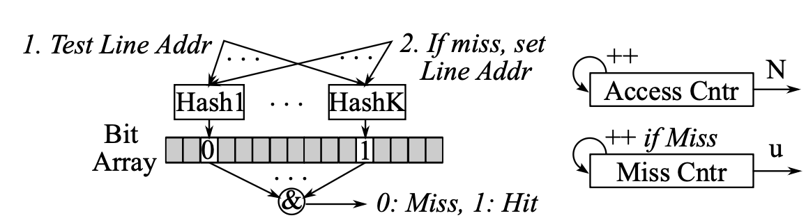
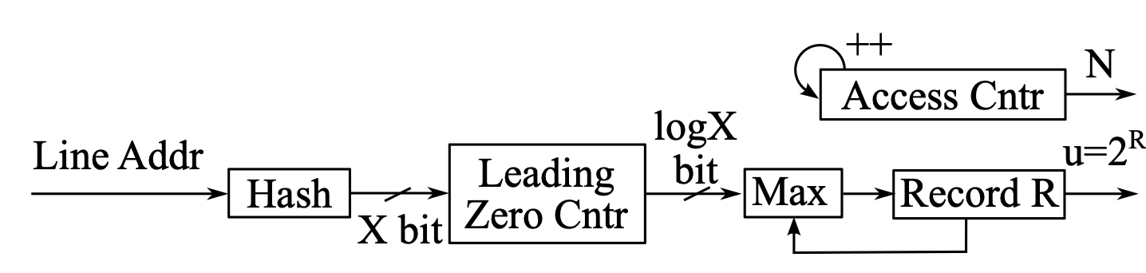
Efficient Cardinality Detection using Probabilistic Data Structures
Use two major classes of probabilistic data structures:
  Bloom Filter – proposed to process membership queries approximately
  Log-Log Counting (e.g., HyperLogLog) – proposed for approx. cardinality detection
We quantitatively compare them in our experiments
  The latter is more space-efficient but is less accurate (accurate enough in our case)
Bloom Filter
Log-Log Counter

Slide 22
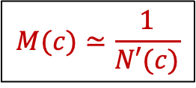
Curve Fitting and Miss Ratio Calculation
Curve fitting: we consider two types of curves to fit
  Monolithic: chosen from power, linear, or exponential curve; general trend detection
  Spline: multiple pieces of 2nd order polynomial curves for finer fitting
Miss ratio calculation: the derivative & inverse of the above curves are known, and the coefficients are identified in the fitting
# of Accesses: N
# of Accesses: N
Miss Ratio: M
$$M(c)≃\frac{1}{N′(c)}$$
Monolithic
Spline
Derivative & Inverse Calculation
Spline
Curve Fitting
Monolithic
# of Unique Accesses: u
# of Unique Accesses: u
# of Unique Accesses: u

Slide 23
Motivation of Miss Curve Synthesis
Objective: To efficiently detect the interference effect when multiple streams share the same cache without acquiring a mixed trace and seeking it
Use cases: Interference-aware process scheduling, DVFS, shared cache management, etc.
Approach: Synthesize miss curves for a mixed stream using existing individual curves
n
m
Program 1
Program 1
Program 1
Program 1
M(u)
M(u)
Program 1
Program 1
M(u)
Program 1
M(u)
M(u)
Program 1
M(u)
Mix of m Programs
M(c)
Program 1
M(u)
M(u)
Program 1
M(c)
M(u)
Program 1
M(u)
Program 1
M(u)
M(c)
u
Interference
u
u
u
u
u
u
c
u
c
u
u
u
One of nCm
Combinations
c
Per-program Curves under Interference
Miss Curve of Mixed Stream
Miss Curves w/o Interference

Slide 24
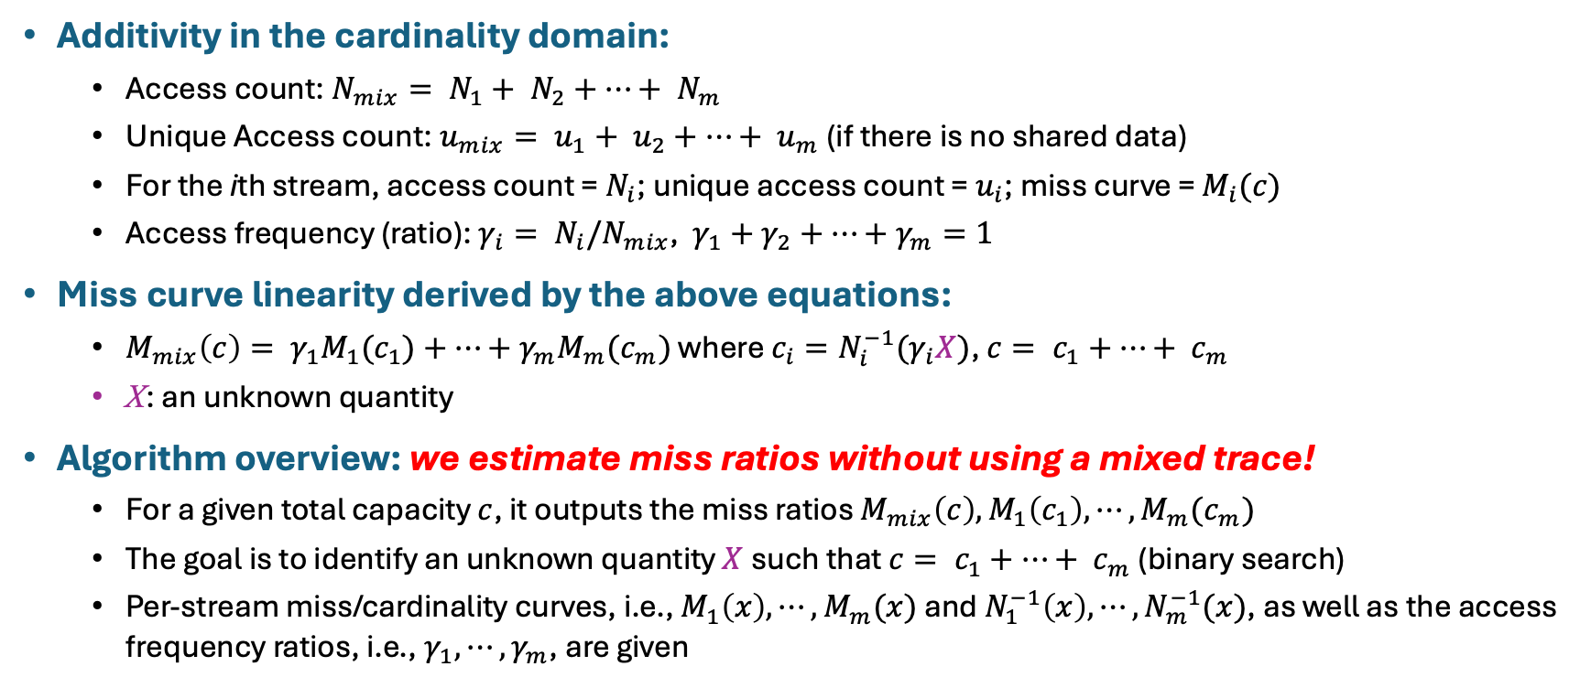
Additivity and Synthesis Algorithm Overview
Additivity in the cardinality domain:
  Access count: $N_{mix}= N_{1}+ N_{2}+⋯+ N_{m}$
  Unique Access count: $u_{mix}= u_{1}+ u_{2}+⋯+ u_{m}$ (if there is no shared data)
  For the ith stream, access count = $N_{i}$; unique access count = $u_{i}$; miss curve = $M_{i}(c)$
  Access frequency (ratio): $γ_{i}= N_{i}/N_{mix}$, $γ_{1}+γ_{2}+⋯+γ_{m}=1$
Miss curve linearity derived by the above equations:
  $M_{mix}\left(c\right)= {γ_{1}M}_{1}(c_{1})+⋯+{γ_{m}M}_{m}(c_{m})$ where $c_{i}=N_{i}^{−1}(γ_{i}X)$, $c= c_{1}+⋯+ c_{m}$
  X: an unknown quantity
Algorithm overview: we estimate miss ratios without using a mixed trace!
  For a given total capacity $c$, it outputs the miss ratios $M_{mix}\left(c\right), M_{1}\left(c_{1}\right),⋯,M_{m}(c_{m})$
  The goal is to identify an unknown quantity $X$ such that $c= c_{1}+⋯+ c_{m}$ (binary search)
  Per-stream miss/cardinality curves, i.e., $M_{1}\left(x\right),⋯,M_{m}(x)$ and $N_{1}^{−1}\left(x\right),⋯,N_{m}^{−1}(x)$, as well as the access frequency ratios, i.e., $γ_{1}, ⋯, γ_{m}$, are given

Slide 25
Outline
Background & Literature
Key Insight on Cardinality
Proposed Method
Evaluation
Conclusion

Slide 26
Evaluation Setup
Inputs: SPEC CPU 2017 memory access traces obtained with PIN
  Useful for hardware-agnostic workload characterizations
  Note, our approach is trace agnostic and applicable to such as PEBS-based component & hardware specific traces
Prototyping: python w/ several commonly-used libraries incl. scipy, qpsolvers, xxHash, etc.
Evaluation & Comparison:
  SD: Stack distance-based miss curve construction (ground truth / baseline)
  RD: Reuse distance-based approach proposed by Eklov et al. (de facto)
  BF or HLL + MFit or SFit: Bloom Filter or HyperLogLog based cardinality detection plus Monolithic or Spline curve Fitting (our approach)

Slide 27
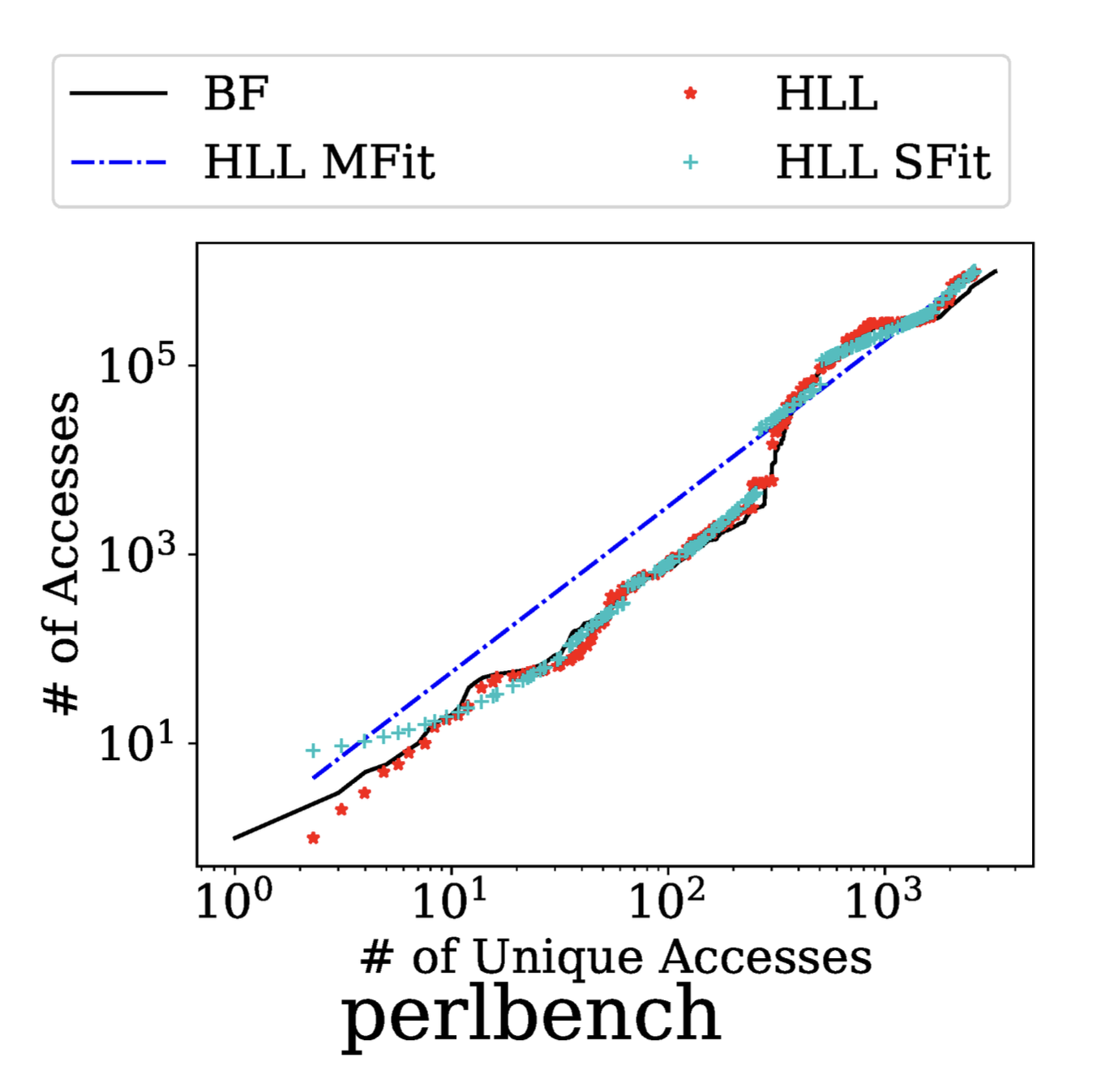
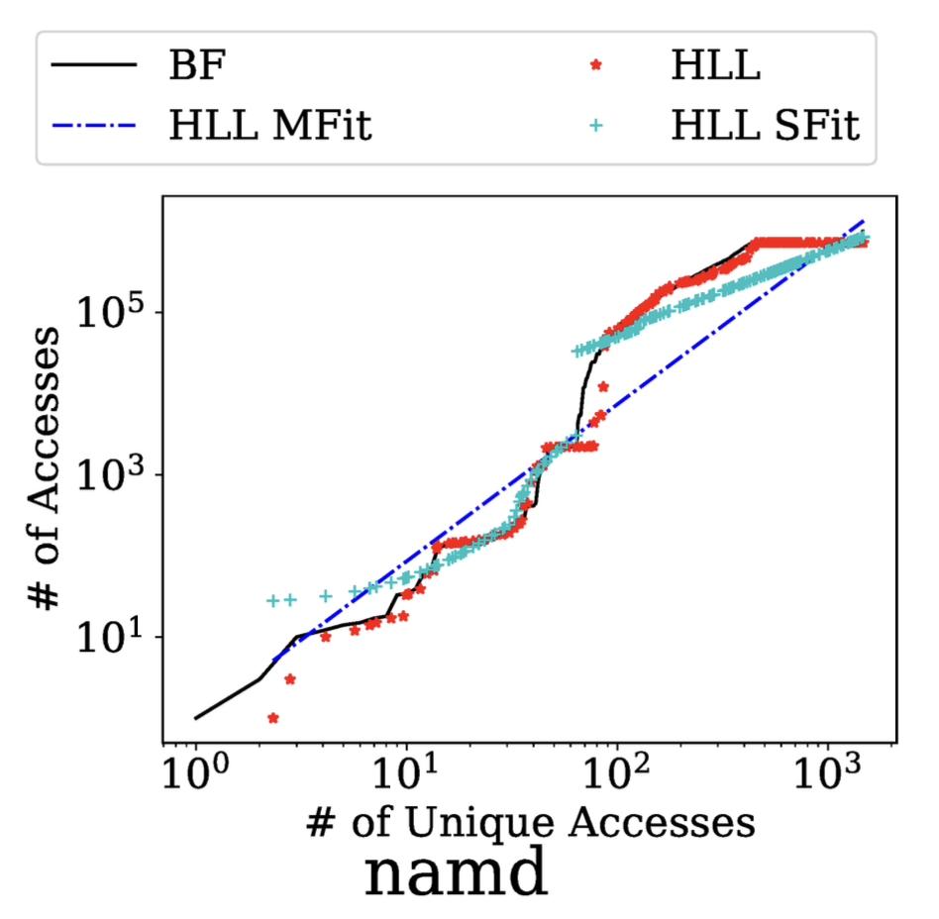
Cardinality Detection & Curve Fitting Result
BF vs HLL: Overall, HLL generates similar discrete cardinality curves to those BF does
Monolithic curve fitting (MFit) can capture the general cardinality trend well
Spline curve fitting (SFit) outputs finer-tuned curves
Only representatives are reported here – we confirmed this trend in the other SPEC programs

Slide 28
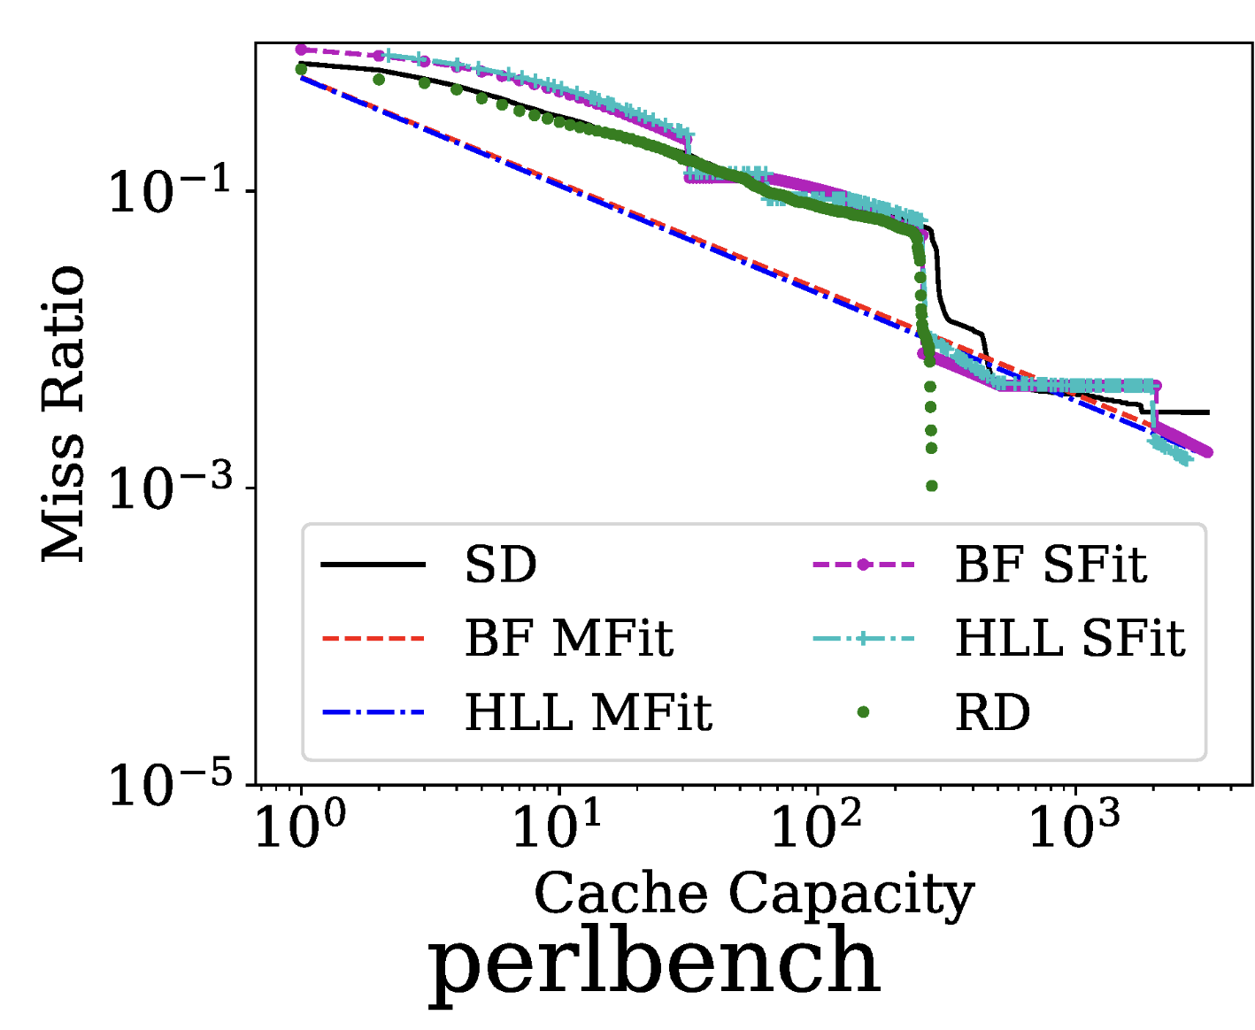
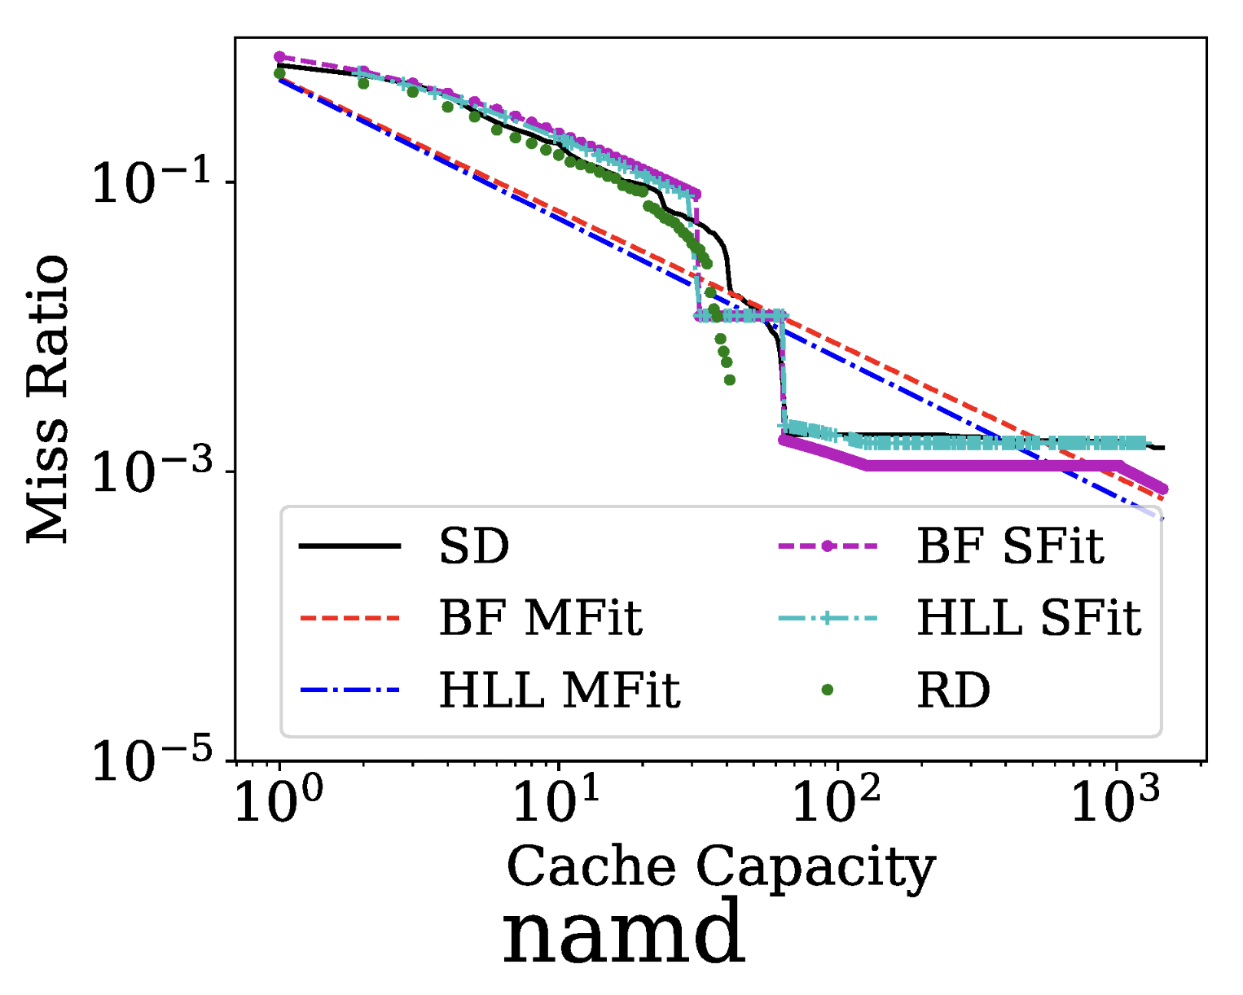
Miss Curve Comparison
SD (Stack Distance) is the ground truth
RD (Reuse Distance) overall well follows the ground truth, but it detects the miss ratio only within a limited capacity range – ours covers a wider capacity domain!
We observed no significant difference between BF and HLL
Mfit generates finer-tuned curves in this domain too

Slide 29
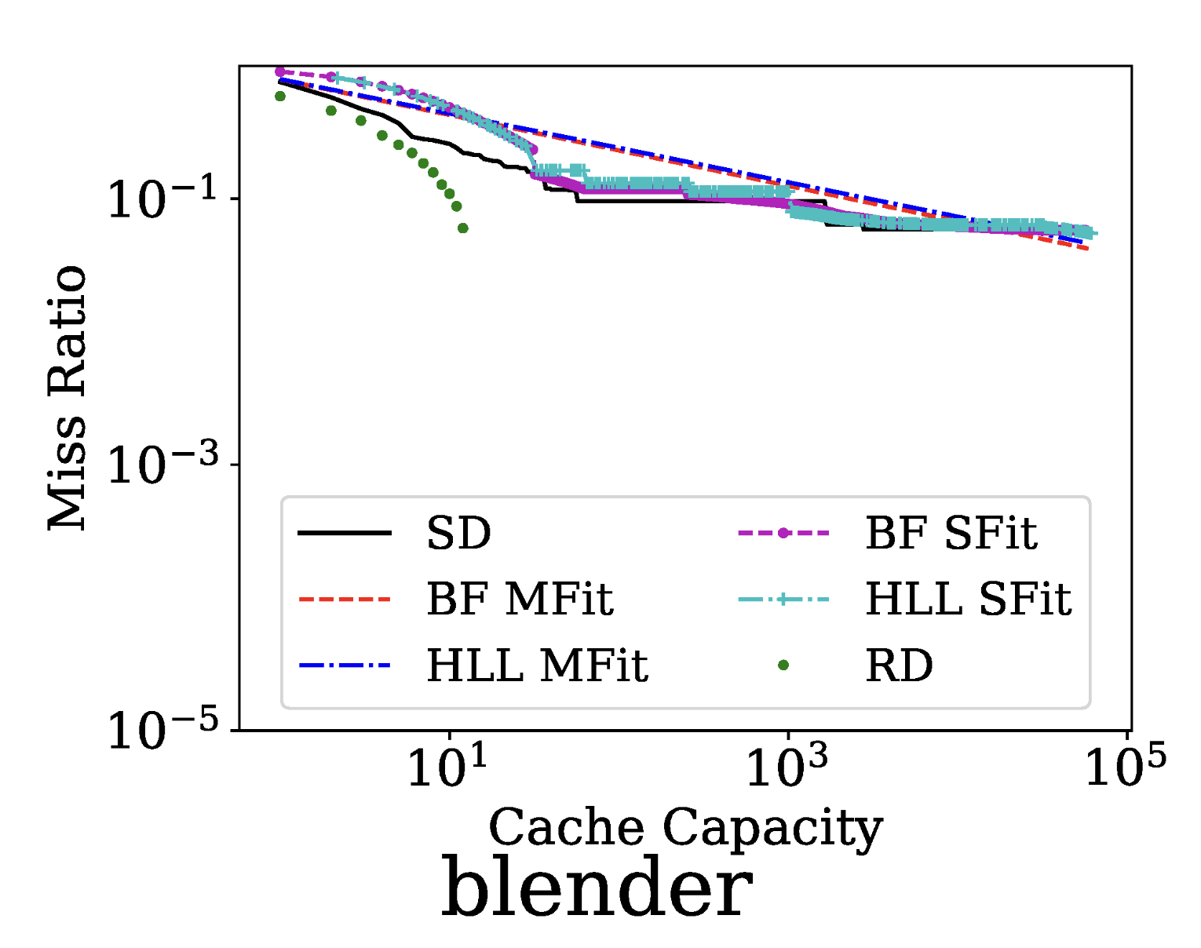
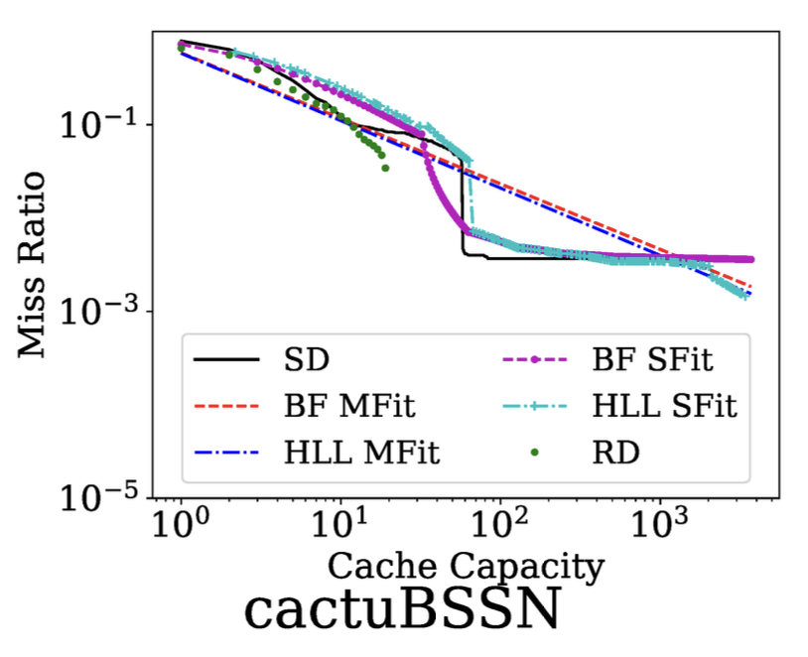
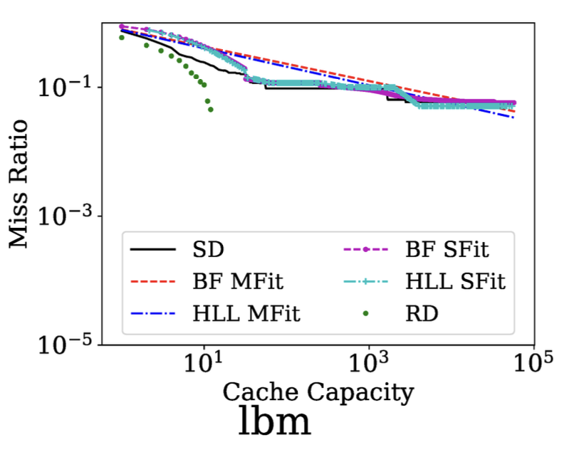
Miss Curve Comparison for
Low Temporal Locality Workloads
The difference between ours and RD becomes more significant when the temporal locality is extremely low
  Common property in modern workloads that induce irregular memory accesses on a huge memory space where the long-tail miss ratio behavior matters to determine the capacity

Slide 30
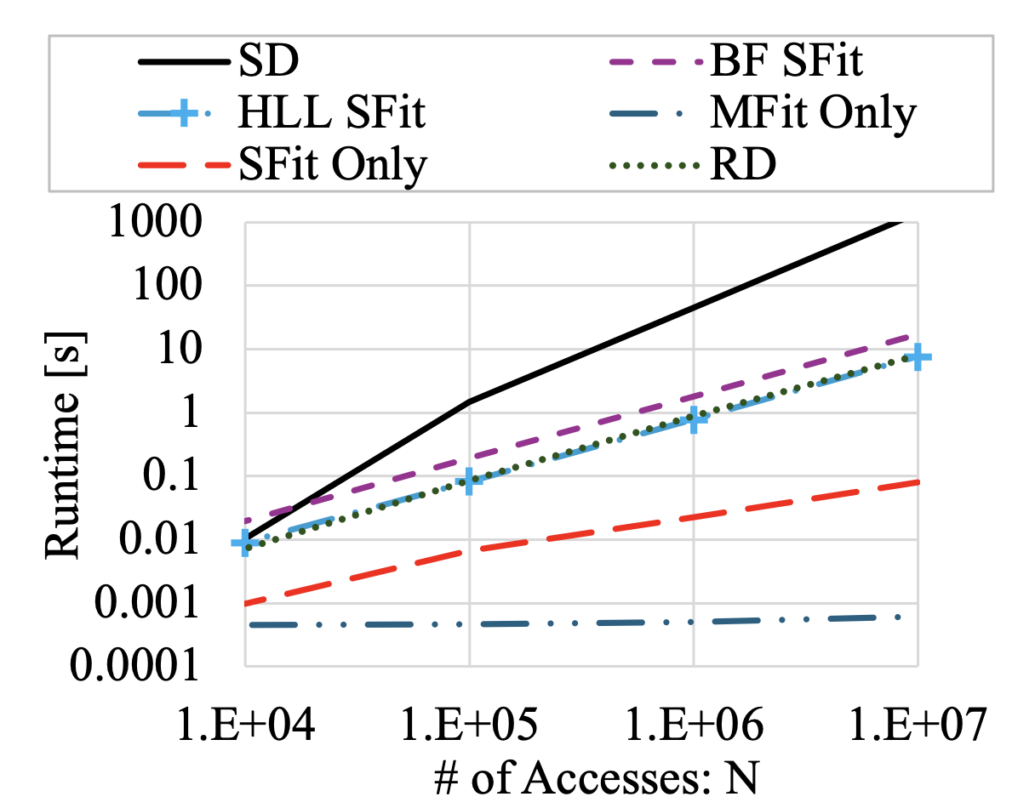
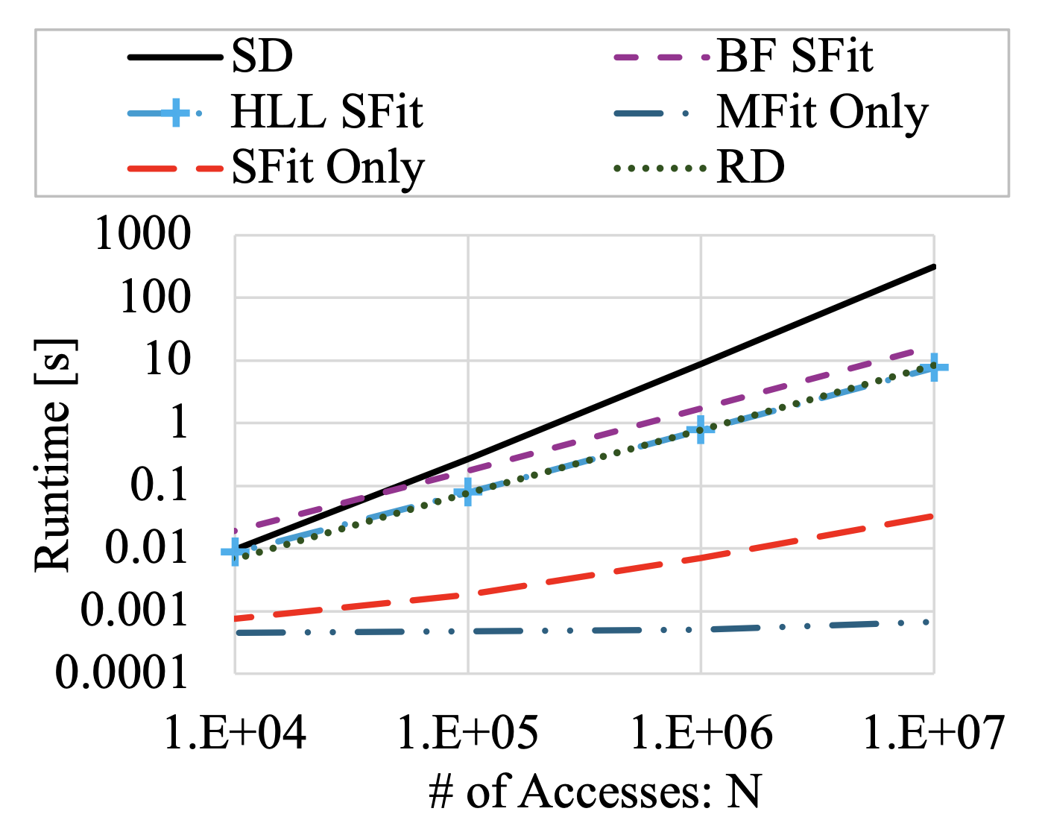
Time Overhead
Time overhead as a function of trace length; MCF (left) and geometric mean (right)
Both of ours and RD can complete the miss curve generation in a linear time (slope = 1)
The curve fitting overhead is negligible compared with trace seeking
(baseline)
(baseline)
MCF
Geomean

Slide 31
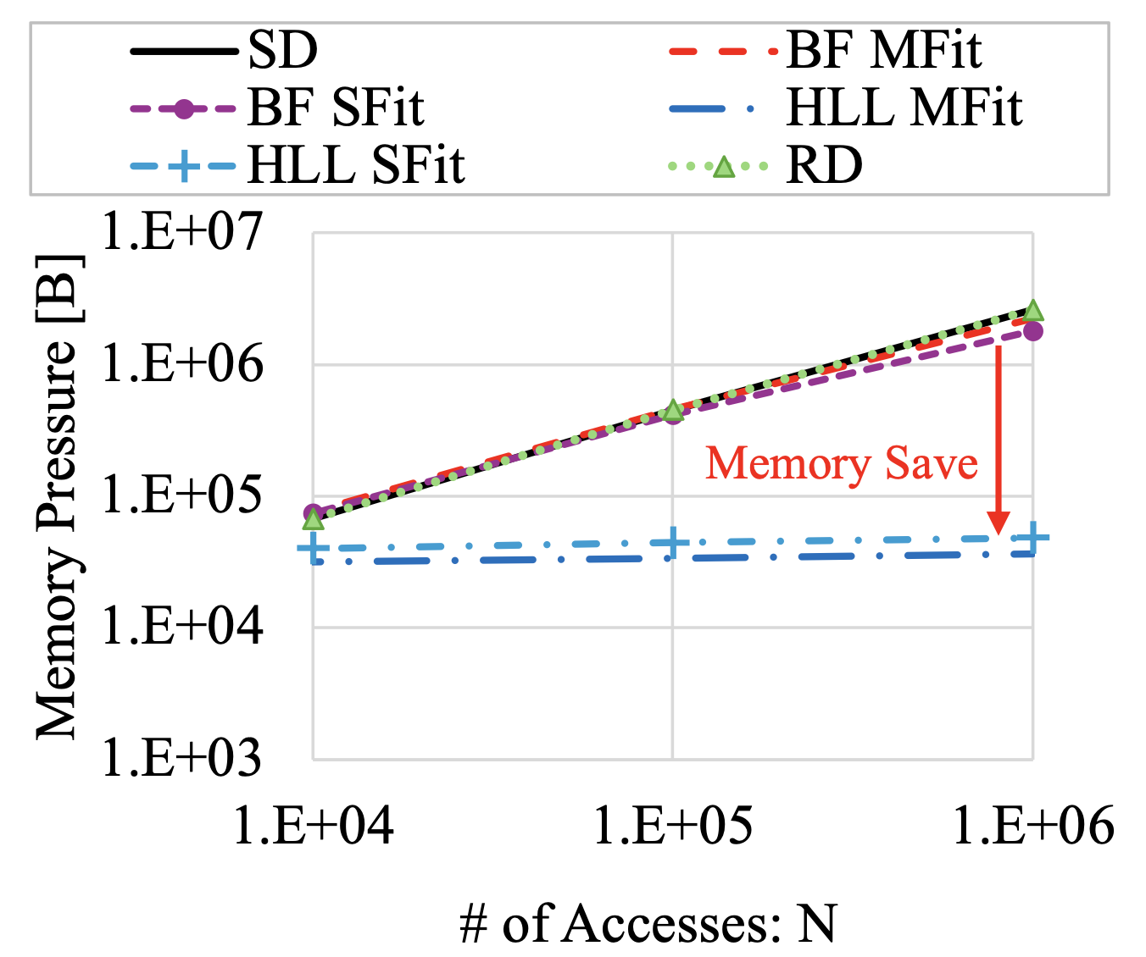
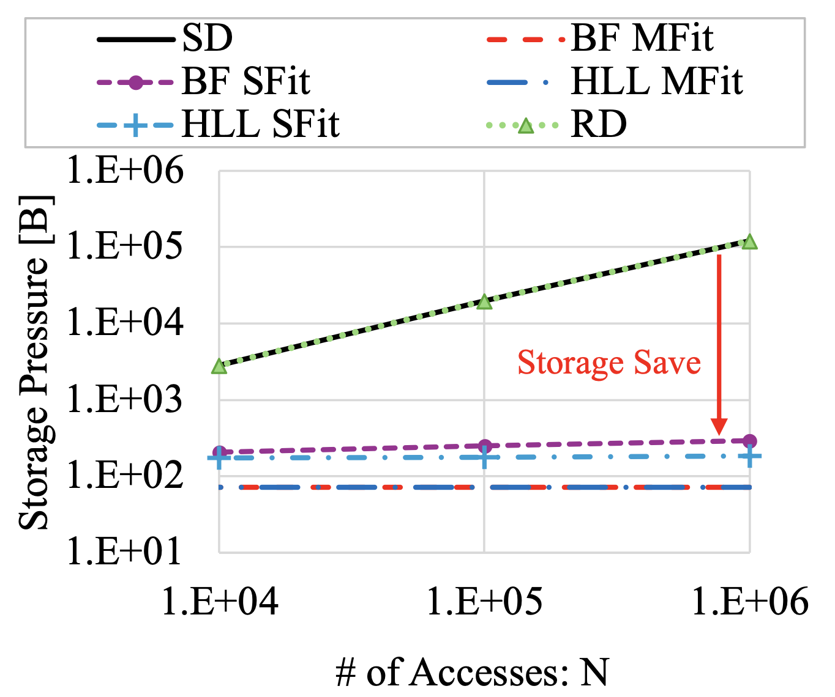
Memory and Storage Overhead
Memory (left) or storage (right) overhead as a function of trace length
Both become constant when using HLL (fitting policy does not matter)
(baseline)
(baseline)
Memory Overhead
Storage Overhead

Slide 32
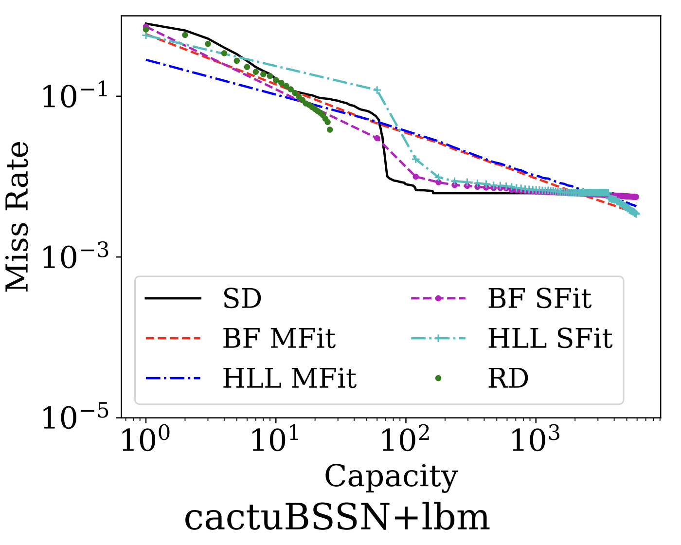
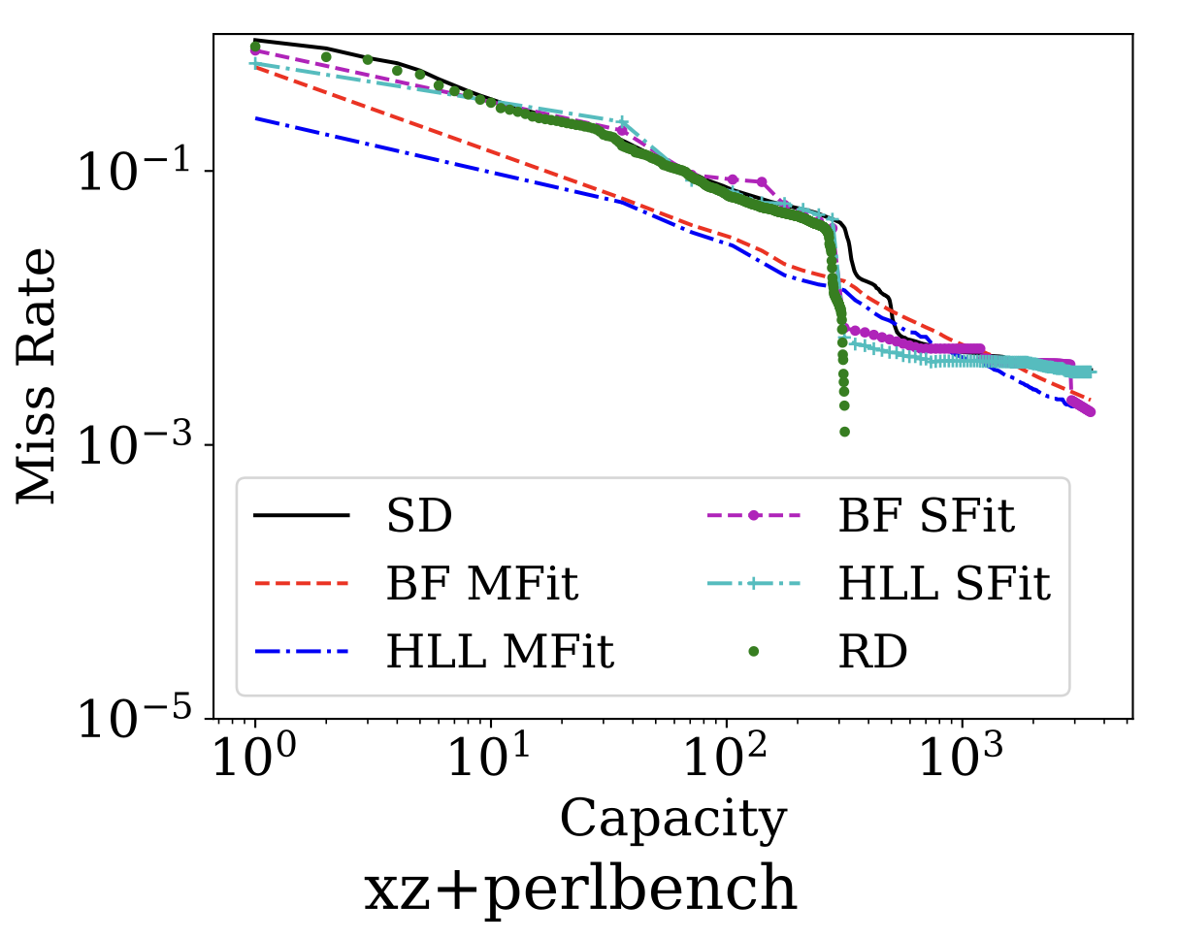
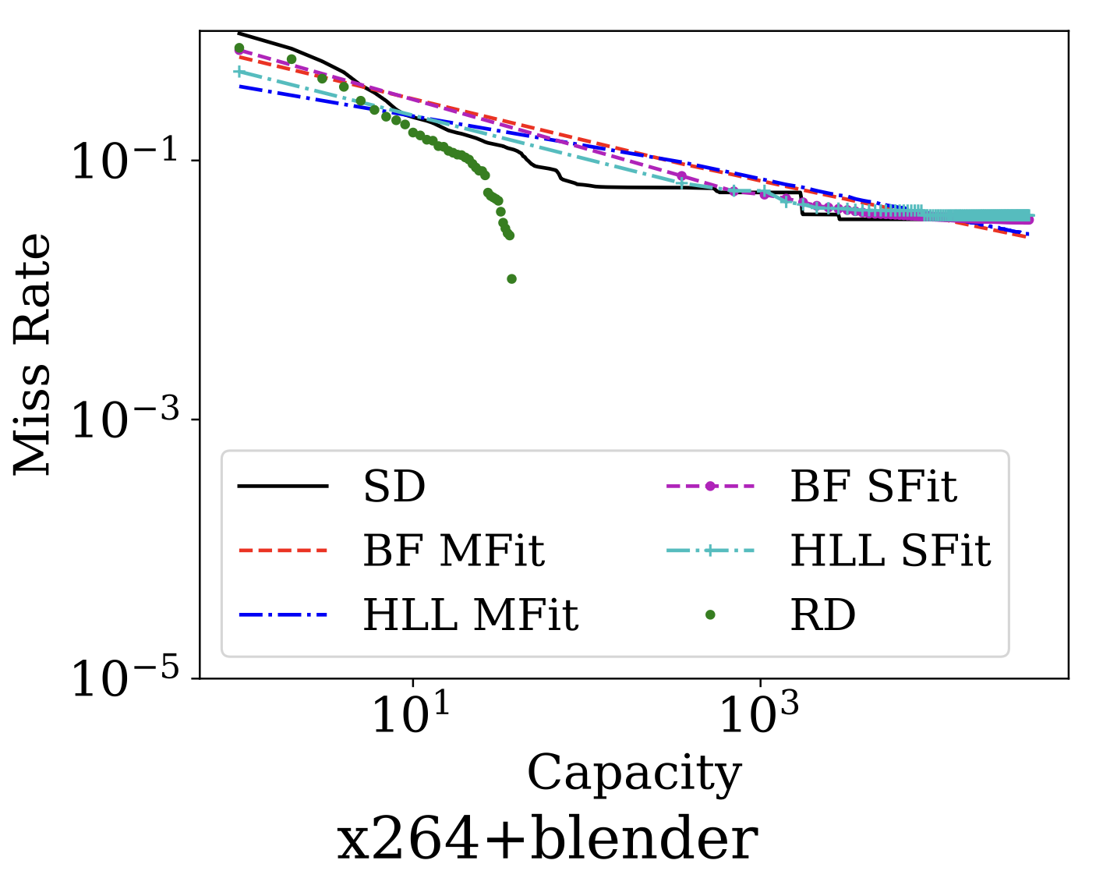
Synthesized Miss Curves
SD/RD: we mixed two traces and input the mix to these detectors
The others: we synthesized the total miss curve using pre-generated individual curves
We observed similar trends to those in the single programmed traces
ground truth

Slide 33
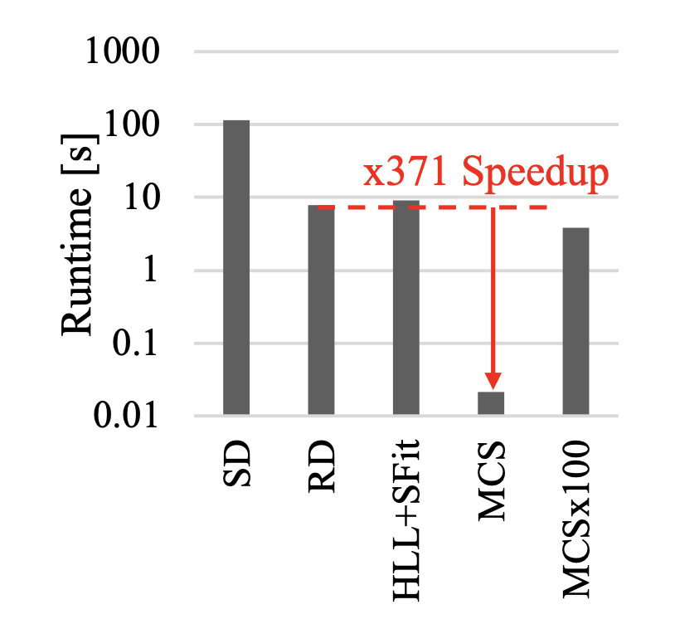
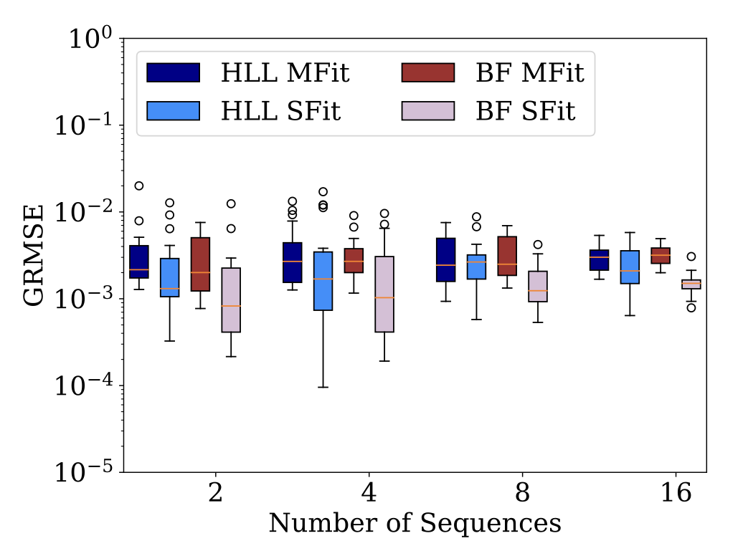
Synthesis Overhead & Error Trend
Left fig: our synthesis algorithm is way faster than mixing traces and seeking it
Right fig: the errors as functions of # of mixed streams – it becomes more robust as we increase # of streams to mix
baseline

Slide 34
Outline
Background & Literature
Key Insight on Cardinality
Proposed Method
Evaluation
Conclusion

Slide 35




Conclusion & Future Work
Contact:
Eishi Arima
eishi.arima@tum.de
CAPS TUM
Contributions:
  Eliminated stack distances from the miss curve estimation procedure by seeing the LRU stack behavior as a series of Bernoulli trials
  Offered an efficient miss curve constriction mechanism using probabilistic data structures and curve fitting as well as a curve synthesis algorithm for mixed streams
  Also explored a compensation mechanism for sampled traces and conducted a parameter sensitivity study (not covered in the talk, see our paper)
Future Directions:
  Integrating our approach with an existing HW-assisted memory-tracing mechanism (e.g., Intel PEBS, AMD IBS, ARM SPE) for online decision making such as process scheduling and resource/power management
  Extending the modeling/theory for more applicability and deeper understanding of locality
Acknowledgment: This work has received funding from EuroHPC JU under grant agreement no. 101093261 and the German Federal Ministry of Research, Technology and Space (BMFTR) under grant no. 16HPC075.

Slide 36
Backups

Slide 37
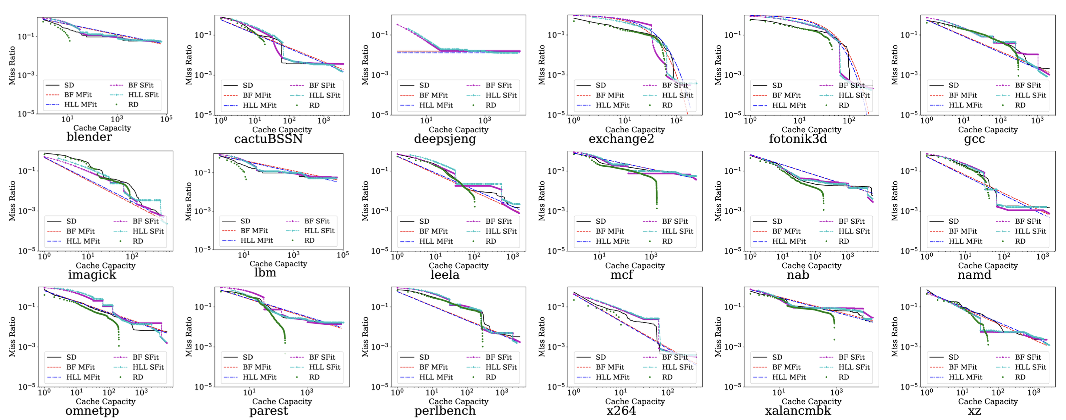
Estimated Miss Curves for
SPEC CPU 2017 Memory Traces

Slide 38
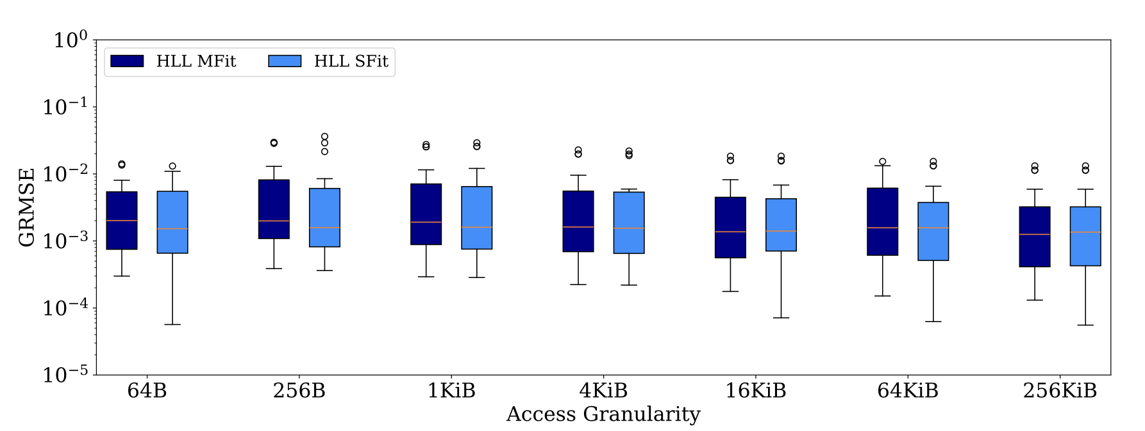
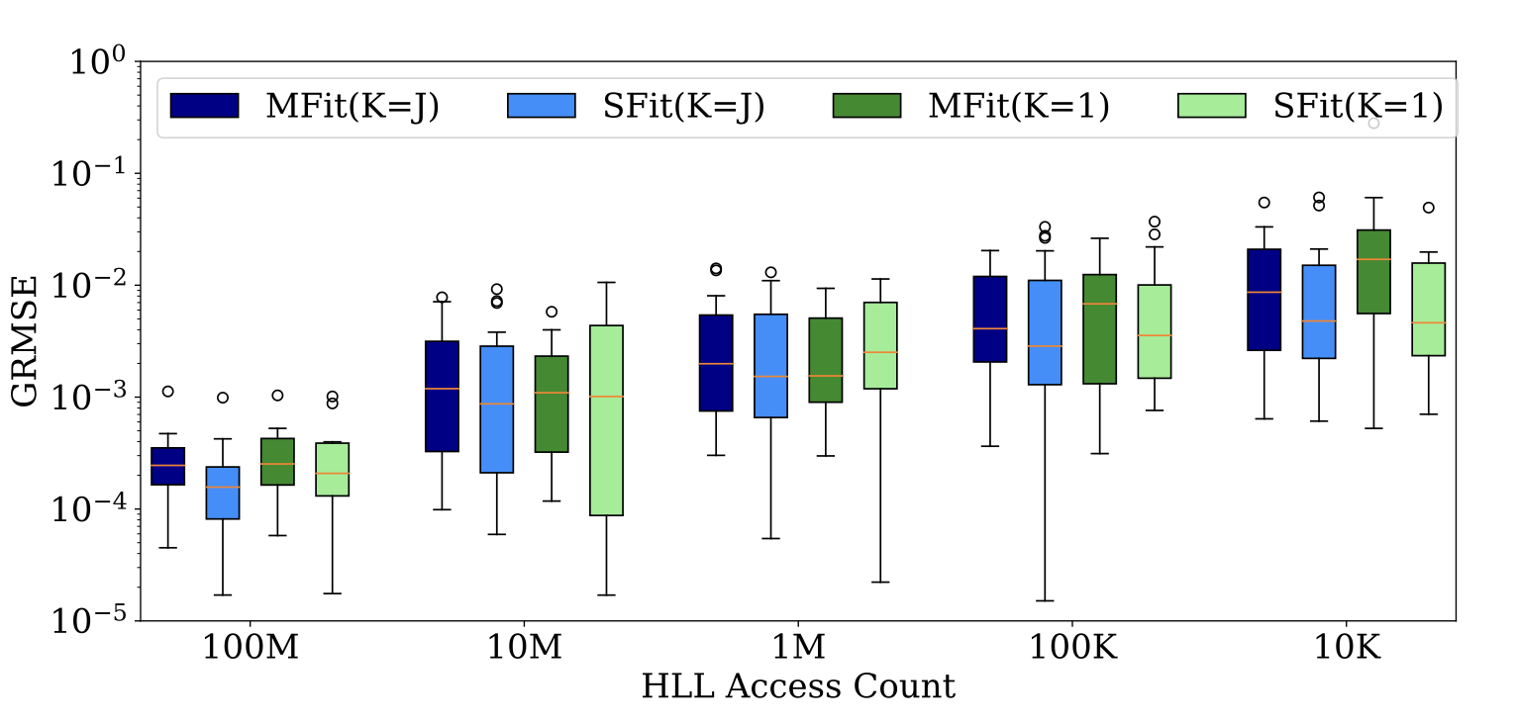
Error vs Access Granularity / Trace Length
Left fig: the error is almost constant when scaling the access granularity
Right fig: the error becomes smaller when scaling the input trace size
  Preferable feature to analyze/manage modern irregular & large footprint workloads

Slide 39
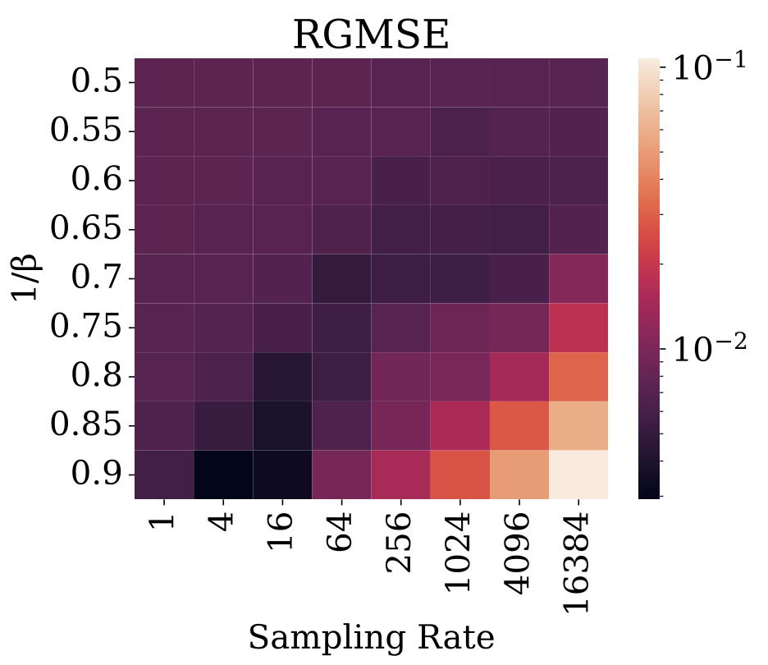
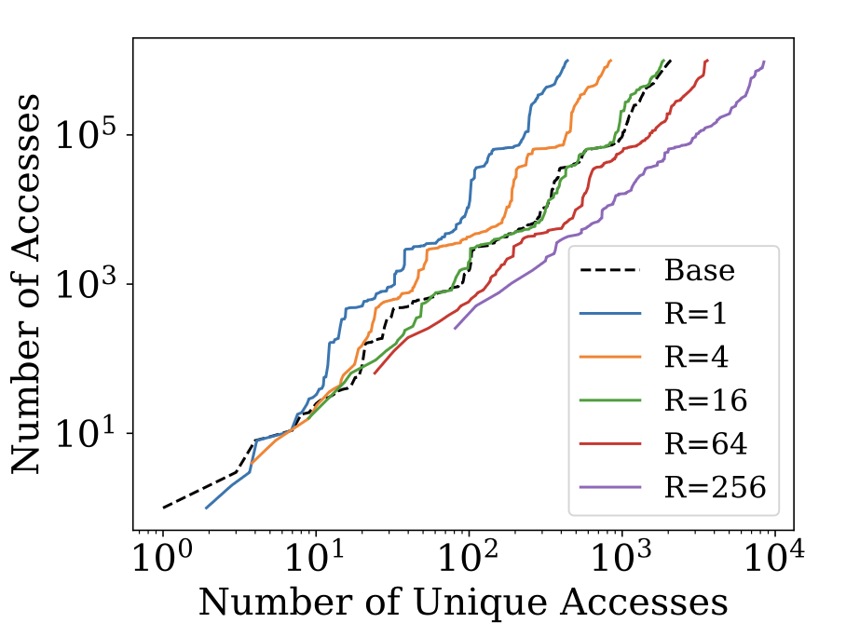
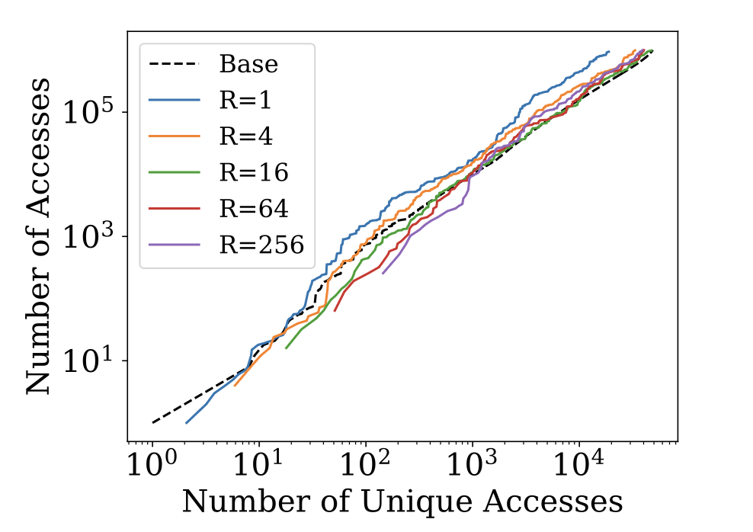
Impact of Sampling & Optimization Opportunity
We offer a compensation mechanism for sampled traces (e.g., w/ Intel PEBS) governed by a parameter β
  Left fig: set the same β for all; the optimal β depends on the sampling rate
  Center / right: the optimal β & the impact of the sampling rate on it depend on the trace
gcc (1/β = 0.8)
blender (1/β = 0.9)

Slide 40
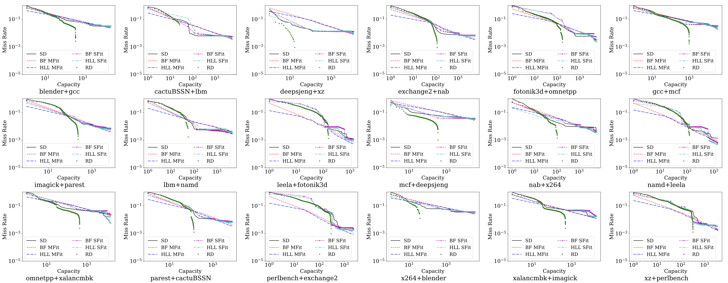
Estimated Miss Curves by SD/RD using Mixed Traces v.s. Synthesized Miss Curves

